Slide 3
PARTNERSHIP
FORMATION PARTNERS
First Public-Private Partnership
Government of State of Andhra Pradesh
University of Hyderabad
Dr. Reddy’s Laboratories Ltd.

Slide 4
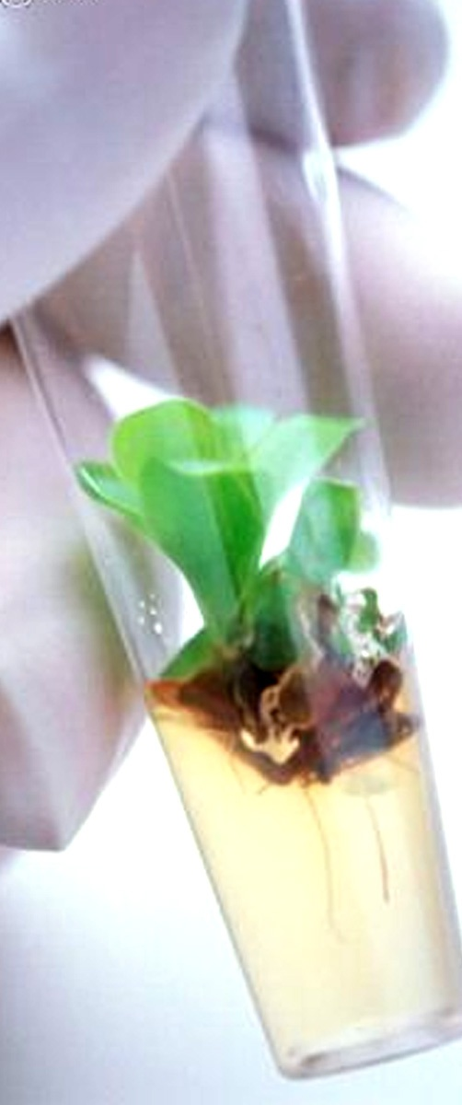
OUR MISSION AND OBJECTIVES
MISSION & OBJECTIVES
To find solutions to improve human health through the application of cutting edge research by integrating various disciplines of Sciences (Life, Information, Chemical & Physical)
Translational Research
Bridging the gap between industry and academic centres
Aligning its research to meet the needs of the Pharma / Biotech industry

Slide 5
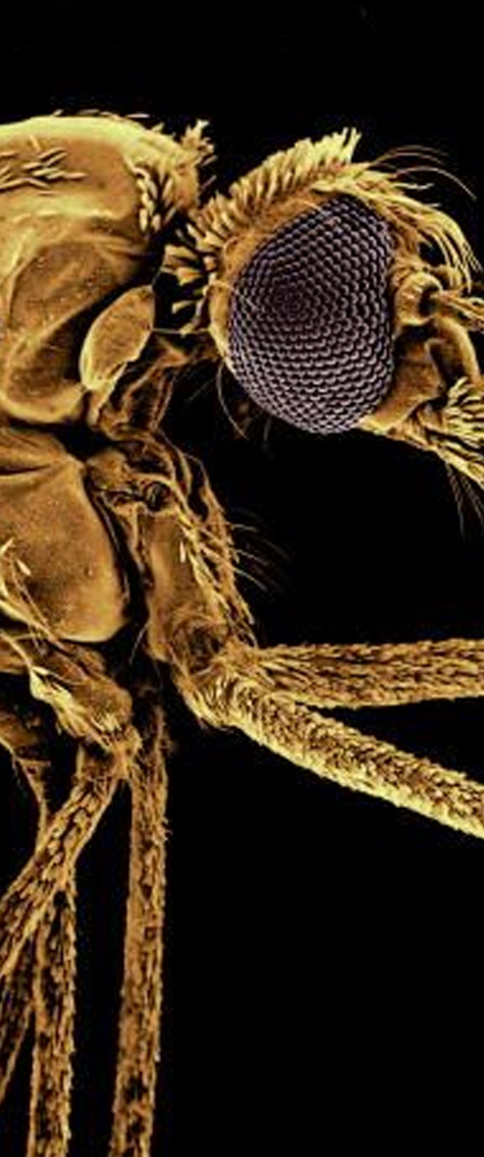
CURRENT FOCUS AREAS
CURRENT FOCUS AREAS
TB and other Infectious Diseases
Diabetes and Obesity
Oncology

Slide 6
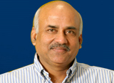
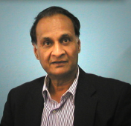
SCIENTIFIC LEADERSHIP @ ILS
SCIENTIFIC LEADERSHIP
Prof . Javed Iqbal , Director ILS
Prof. Goverdhan Mehta, FRS, Eli Lilly Chair Professor and Distinguished Research professor at ILS
Bhatnagar Fellow and former director of the Indian Institute of Science,
Former vice chancellor of the University of Hyderabad.
Prof. Seyed E Hasnain
Vice Chancellor, University of Hyderabad
Distinguished Research Professor at ILS
First Indian to be awarded the prestigious
Koch Prize in 2009
Prof . Dipankar Chaterji
Astra Chair Professor at IISc, Bangalore, and Distinguished Research Professor at ILS

Slide 7
SCIENTIFIC TEAM @ ILS
Scientific Team @ ILS
Team Member | Role | Years | At
Prof. Javed Iqbal | Director | 30+ | IIT, Kanpur RRL, Trivandrum & Dr. Reddy’s
Prof. Prabhat Arya | Chemical Biologist | 25+ | OICR, Univ of Ottawa, NRC - Canada, McGill Univ, Cambridge Univ & NCL, Pune
Dr. Parimal Mishra | Biologist | 12 | Dr. Reddy’s & Wockardt
Dr. Manojit Pal | Medicinal Chemist | 14 | Dr. Reddy’s & Matrix Labs
Dr. Sreedhara Voleti | CADD Specialist | 9 | UCB & Ranbaxy
Dr. Prasenjit Mitra | Biologist | 5 | Zydus Cadila
Dr. Rajmohan Poondra | Medicinal Chemist | 8 | Dr. Reddy’s
Dr. Kishore Parsa | Biologist | 1 | Matrix Labs
Dr. Anil Kumar | Medicinal Chemist | 14 | Satya Sai University
Dr. Devyani Haldar | Biologist | 6 | NIH, Bethesda, MD, USA
Dr. Kiranam Chatti | Biologist | 4 | Stony Brook, NY
Dr. Anil Challa | Biologist | 6 | Ohio State University & UCSD
Dr. MS Reddy | Biologist | 4 | Univ Manitoba, Yale
Dr. Arvindh Shanmugam | Biologist / Proj. Mgt | 9 | Johns Hopkins

Slide 8
SCIENTIFIC NETWORK of ILS
SCIENTIFIC Network of ILS
SCIENTIST | Role @ ILS | From
Prof. SEYED E HASNAIN | Distinguished Research Professor | Robert Koch Prize Winner 2009, VC, Univ of Hyderabad, Adjunct Prof, JNCAS, Bangalore
Prof. GOVERDHAN MEHTA | Distinguished Research Professor | Eli Lilly Chair Professor, IISc, Bangalore
Prof. DIPANKAR CHATTERJI | Distinguished Research Professor | ASTRA Chair Professor IISc, Bangalore
Prof. OILVER REISER | Adjunct Faculty | University of Regensburg, Germany
Prof. ASHWINI NANGIA | Adjunct Faculty | University of Hyderabad, Hyderabad
Dr. SANDEEP DUGAR | Adjunct Faculty | Sphaera Pharma, Singapore
Dr. SHIREEN VALI | Adjunct Faculty | Cellworks Res. India Ltd., Bangalore
Dr. Nasreen Z Ehtesham | Visiting Research Scientist | Deputy Director, NIN, Hyderabad
Dr. B GOPALAN | Visiting Scientist | Orchid Pharma, Chennai
Dr. UDAY SAXENA | Visiting Scientist | Kareus Therapeutics, USA
Prof. UTPAL TATU | Visiting Scientist | Indian Institute of Sc., Bangalore
Dr. SANJEEV GALANDE | Visiting Scientist | Nat. Centre for Cell Science, Pune
Dr. GOKHAN HOTAMISLIGIL | Collaborator | Harvard Medical School, USA
Dr. CHRISTOPHER SCHOFIELD | Collaborator | Oxford University, England
Prof. VS CHAUHAN | Collaborator | ICGEB, New Delhi
Dr. KANURI VS RAO | Collaborator | ICGEB, New Delhi

Slide 9
Investor Presentation
CONCEPT
&
Formation of SPINOUT Technologies --- > COMPANIES
Over a Period of last 4 Years of operations ILS has carried out cutting-edge research and it has identified highly Innovative Niche technologies coming out of its in-house research. These technologies have great market potential as they would fit nicely in the portfolio of a big and mid-size Pharmaceutical company. The big-Pharma model has failed and they will have to now rely on innovation being carried out at academia and start-up companies.
As ILS is a Section 25 Company , it has started a venture arm named IQgen LIFE SCIENCES PVT.LTD. , to spin out technologies in the form of start-up Companies which shall be incubated within ILS and can later go on to become independent stand alone companies .
Diversified Risk free Investment Model

Slide 10
Investor Presentation
Technologies which have been incubated as start-up companies at ILS
Initial drug discovery through unique co-crystal approach
This was started with initial funding of Rs.1 Crore by External Investor in 2009.
The Company was incubated for 2 Years and filed 6 Patents with 2 International Patents , One of the Drug Molecule is Valued at Rs. 6 Crores and is being Out Licensed to a Large Pharma Company
THE FIRST SUCCESS STORY AT ILS
Diversified Risk free Investment Model

Slide 11
Investor Presentation
Technologies which have been incubated as start-up companies at ILS
Innovative Medicinal Chemistry CRO and Process Development
This was started to make ILS self sufficient in its burnrate requirement
As an Independent service vertical started in June 2010 , COSMIC , posted a net profit of Rs.3.1 Crores ,
The Current Value of COSMIC is Rs.68 Crores
THE SECOND SUCCESS STORY AT ILS
Diversified Risk free Investment Model

Slide 12
Investor Presentation
With Two Successes in a Row , ILS is incubating the following technologies as Private Limited Companies :
Zebrafish Pharmaceutical Services:
Providing services to Pharma companies to assess the safety of their drugs. Company based on Innovative technologies development ( $ 5-10 m)
Anti Cancer Vaccines with 3 Patents in collaboration with Monash University, Australia and early CANCER detection Devices ($25-30 m)
PEPTOMEDICA
LIFESCIENCES
Providing Services to Pharmaceutical companies in Preclinical research using cell lines and animals: Service and IP based revenue model ( $40-50 m)
Providing services to Pharmaceutical companies in patentable and non-patentable drug like molecules: Service and IP based revenue model ( $ 15-20 m)
Diversified Risk free Investment Model

Slide 13
Investor Presentation
SELECTION OF TECHNOLOGIES TO BE INCUBATED
External Technology
IQgen Life Sciences Scientific Management Committee
Consisting of Eminent International Scientists
Picks up New Technologies With Market Potential
EVUALATION
YES
NO
New Company
Plan Dropped
Diversified Risk free Investment Model

Slide 14
Investor Presentation
IQgen Life Sciences
Scientific Management Committee
Prof Goverdhan Mehta, FRS, Former Director of IISc, Bangalore, Scientific Advisor to PM
Prof Randal Peterson, Professor in Biology, Harvard University USA
Prof Graham Richards, OBE, Professor in Bioinformatics, Oxford University, UK
Prof Ashok Venkitaraman, Professor in Biology, Cambridge University, UK
Prof Johan Auwrex, Professor in Biology, EPFL, Laussane, Switzerland
Prof Colin Suckling, Professor in Organic Chemistry, Strythclyde University, Glasgow, UK
Prof Ian Fleming, FRS, Professor in Organic Chemistry, Cambridge University, UK
Dr Peter Machin, Former Senior Vice President in Drug Discovery, Glaxo Smith Kline, UK
Dr Anoop Mishra, Executive Chairman, Fortis C-DOC, Fortis Hospital, New Delhi
Dr Swami Subramanian, Director, Worldwide Licensing & External Research, Merck, USA
Dr Raman Govindarajan, Head, India R&D, Member Asia Pacific R&D Team, Sanofi-Aventis, France
Prof Javed Iqbal, Director, ILS, Hyderabad
Diversified Risk free Investment Model

Slide 15
Investor Presentation
STURCTURE OF NEW COMPANIES
Diversified Risk free Investment Model

Slide 16
Investor Presentation
INCUBATION MODEL and FINANCIAL RELATIONSHIP WITH ILS
Will pay Monthly Incubation fees + 20 % Share of any Buy Off / OUT LICENCE TECHNOLOGY
COMPANY
ILS
ILS to provide :
Transfer Existing technologies and dedicate the Facilities
Dedicated Lab Space
Dedicated Scientific Leadership
Dedicated Manpower.
SCM support
Admin Support.
Diversified Risk free Investment Model

Slide 17
Investor Presentation
COMPANY’S PROGRESS MODEL
As the company is focusing of niche technology which large pharma company can see a Value addition and buy off a segment or the whole company itself:
The Incubated Company focuses on Increasing its Value through adding Intellectual Property consistently in the area by way of filing patents .
At the same time the company also aims at recovering its cost of operations and some component of dividend to the equity holders
Time Frame of expected out license /buyout is 3-5 Years.
Diversified Risk free Investment Model

Slide 18
Investor Presentation
COMPANY’S PROGRESS MODEL
Option of continuing or exiting from Incubation model as separate company
Exploratory Development POC Filing Stage
Development for further Methods and Products by filing more patents
Opex Yr 3 - 5
Develop & Standardize Procedure - Patent
OPEX YEAR 2
Good ROI and Dividends
Ready for Out License / Buy OUT
Meets Break Even and also Gives Dividends
CAPEX & OPEX YR 1
Starts revenue
INITIAL COMPANY FORMATION
With / without Patents
Diversified Risk free Investment Model

Slide 19
Investor Presentation
COMPANY- IQGEN- ILS RELATIONSHIP
PEPTOMEDICA
LIFESCIENCES
Diversified Risk free Investment Model

Slide 20
Investor Presentation
THANK YOU
Diversified Risk free Investment Model

