Slide 1
Towards World Class Institutions of Higher Education in Science and Engineering MHRD Workshop on “Leadership for Academicians Program” 22 February 2019
Prof. Anurag Kumar
Director
Indian Institute of Science

Slide 2
Outline
World class universities
Examples, and some characteristics
IISc overview
Origins, history, growth, and current status
Strengths, uniqueness, and some practices
Some good practices around the world
Challenges in our ecosystem
Corresponding initiatives at IISc
Conclusion

Slide 3
World University Rankings: Country Representation (THE Rankings): Feb 2019
 | USA | UK | Europe (~UK) | China | S. Korea | Japan | India
Top 10 | 7 | 3 | 0 | 0 | 0 | 0 | 0
Top 20 | 15 | 4 | 1 | 0 | 0 | 0 | 0
Top 30 | 18 | 7 | 1 | 1 | 0 | 0 | 0
Top 40 | 23 | 8 | 4 | 2 | 0 | 0 | 0
Top 50 | 27 | 8 | 8 | 2 | 0 | 1 | 0
Top 100 | 44 | 12 | 25 | 3 | 2 | 2 | 0
Top 150 | 52 | 21 | 49 | 6 | 4 | 2 | 0
Top 200 | 63 | 30 | 70 | 7 | 5 | 2 | 0
Top 300 | 86 | 40 | 111 | 7 | 7 | 5 | 1
Top 400 | 110 | 59 | 149 | 12 | 9 | 6 | 2

Slide 4
World University Rankings: Country Representation (QS Rankings): Feb 2019
 | USA | UK | Europe (~UK) | China | S. Korea | Japan | India
Top 10 | 5 | 4 | 1 | 0 | 0 | 0 | 0
Top 20 | 11 | 5 | 1 | 1 | 0 | 0 | 0
Top 30 | 14 | 6 | 2 | 2 | 0 | 1 | 0
Top 40 | 16 | 8 | 2 | 2 | 2 | 2 | 0
Top 50 | 19 | 8 | 3 | 3 | 2 | 2 | 0
Top 100 | 33 | 18 | 16 | 6 | 5 | 5 | 0
Top 150 | 39 | 23 | 39 | 7 | 6 | 8 | 0
Top 200 | 48 | 29 | 61 | 7 | 7 | 9 | 3
Top 300 | 59 | 38 | 93 | 12 | 8 | 11 | 6
Top 400 | 77 | 47 | 130 | 14 | 12 | 14 | 7

Slide 5
World University Rankings: Top 10 (Feb 2019)
 | THE | QS | ARWU
1 | U Oxford | MIT | Harvard U
2 | U Cambridge | Stanford U | Stanford U
3 | Stanford U | Harvard U | U Cambridge
4 | MIT | CalTech | MIT
5 | CalTech | U Oxford | UC Berkeley
6 | Harvard U | U Cambridge | Princeton U
7 | Princeton U | ETH | U Oxford
8 | Yale U | Imperial College | Columbia U
9 | Imperial College | U Chicago | CalTech
10 | U Chicago | UCL | U Chicago

Slide 6
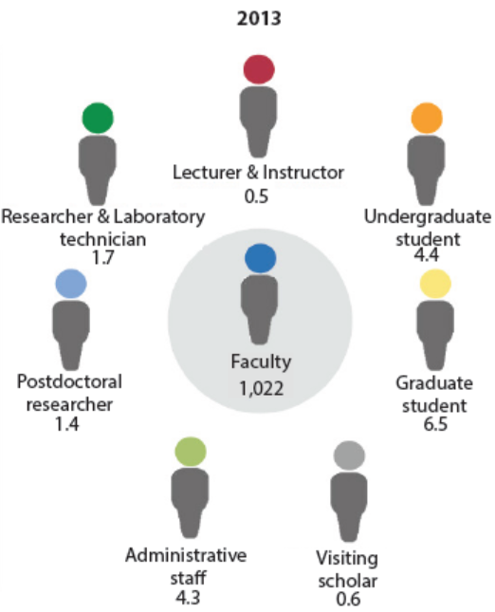
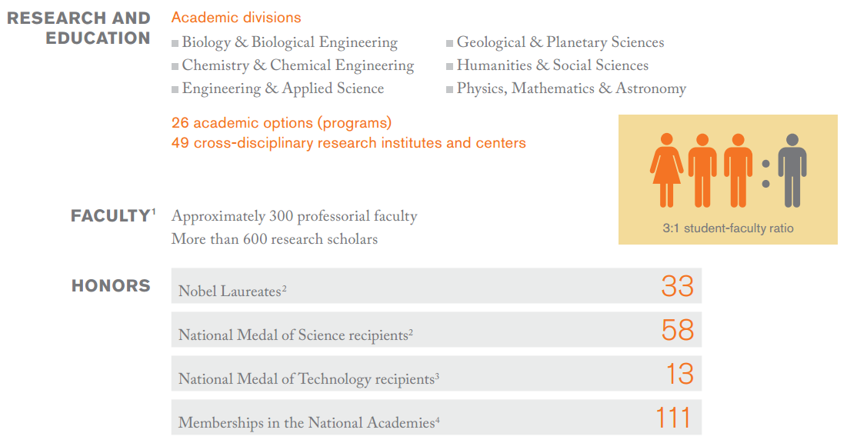
Caltech and MIT
3900 support staff
Nobel laureates 81
National Medal of Science 39
National Medal of Technology 2
National Academy of Science 79
National Academy of Engg. 59
caltech.edu; Future of MIT Report 28 July 2014

Slide 7
Caltech (ARWU #7): Beyond the Ranking Criteria
Core philosophy: “… to develop research programs at the cutting edge that will excite and interest people from around the world given their relevance to major global challenges today.”
The President’s statement: “… we always try to get involved in exciting science, but also science that has a lot of potential for society. The most important part is to do work that is critical for the future of the country and the world….”
Caltech’s philosophy of research is very much focused on fundamental research looking into basic questions about the world around us.
Recent achievements and initiatives: discovery of Gravitational Waves under the LIGO project, link between intestinal microbes and neurogenerative disease, Joint Centre for Artificial Photosynthesis
Vice Provost: “This is not a top-down university…we don’t have boundaries between departments… we provide the environment and let the faculty decide on the areas they want to study”
shanghairanking.com

Slide 8
MIT (ARWU #3): Beyond the Ranking Criteria
“… enthusiasm for interdisciplinary research, focusing on collaborative research efforts across disciplines and institutions investigating solutions to some of the world’s major challenges from sustainable energy solutions through to revolutionary treatments for cancer. MIT boasts over 50 interdisciplinary research centres...”
In 2011, MIT disclosed 632 inventions, were issued with 152 patents, and earned approximately US$ 150 million in royalty payments.
Recently, over 750 companies were working with MIT on topics of mutual interest
… 26,000 companies have been started by MIT alumni, employing over 3.3 million people with total revenues of US$ 2 trillion
Contributions: Human Genome Project, Artificial Intelligence, Robotics, … synthesis of Penicillin, Vitamin A, …practical Microwave Radar, and Magnetic Core Memory…detection of Gravitational Waves
shanghairanking.com

Slide 9
Expected Outputs
Impact on Science and Technology: publications and patents
Well-placed, successful alumni: sought-after experts and luminaries
Impact on Society: industrial innovation, S & T policy, scientific ambience
World Class University of Higher Education and Research
Faculty and Students: Hiring the best, and getting the best out of them
International Outlook: faculty, student exchange and travel; collaborative programs
Infrastructure, admin support, research facilities, and funding
Required Inputs

Slide 10
A Sample KPI* Chart for a Research Institute/University
Impact on Science and Technology: publications and patents
Well-placed, successful alumni: sought-after experts and luminaries
Impact on Society: industrial innovation, S & T policy, scientific ambience
Institute/University
(An Example)
Faculty and Students: Hiring the best, and getting the best out of them
International Outlook: faculty, student exchange and travel; collaborative programs
Infrastructure, admin support, research facilities, and funding
*KPI: Key Performance Indicators

Slide 11
IISc: Origins, history, academic growth, current status

Slide 12
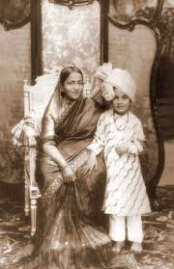
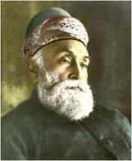
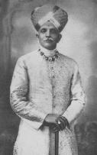
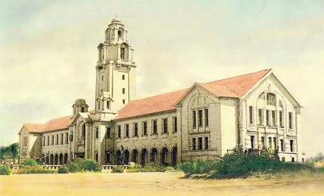
Indian Institute of Science (IISc)
Established in 1909
Government of India
Jamsetji Tata
Maharaja of Mysore
Jamsetji N. Tata, founder of Tata Sons
Conceived of IISc in 1892, shortly after the establishment of research universities in the US, such as Johns Hopkins and Caltech
Higher education and research in science and in engineering
Earliest departments: Chemistry and Electrotechnology
First batch of students admitted in 1911

Slide 13
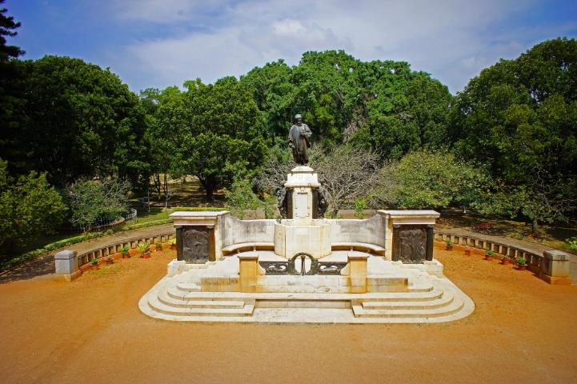
The Institute’s Mandate
To provide for advanced instruction and to conduct original investigations in all branches of knowledge and, in particular, such branches of knowledge as are likely to promote the material and industrial welfare of India
Notes:
Positioning IISC as a global Institution was the vision and mandate set by our founder and this vision and target guides us today too

Slide 14
Departments: 1909 - 2018
General
Chem (IPC)
Elec Tech (EE) & Org. Chem.
Biochemistry
Physics
Micro & Cell Bio
Aero Engg
Chem Engg
ME, Mat Engg
1909
1911
1921
1933
1941
1942
1943
1945
CAF, MBU,
CCT
Comp Sci & Automation
Supercomputer Centre
SSCU
ESE, CST
Math
Civil Engg
ECE
1976
1974
1971
1970
1969
1956
1950
1946
NMR Research
Mat. Research
Atm & Oceanic
Sciences
Ecological
Sciences
Management
Studies
Mol. Rep., Dev. & Genetics
Instr. &
Applied Phy
Product Design & Manufacturing
1977
1978
1982
1983
1985
1989
1996
1998
BSSE
ICWAR CDS
Infectious Diseases Research
Energy Research
Cyber Physical Systems
Nano Sci & Engg
CNS, DCCC, CiSTUP
CCS,
CHEP
Earth Sciences
2015
2014
2012
2011
2010
2009
2007
2004

Slide 15
Degree Programs: 1909 - 2018
AIISc, FIISc, Honorary Fellowship
1990
Int. PhD programme
First institution in India
1911
DIISc (Master’s program equivalent for BSc & BE students)
MDes & MBA started
ME (Int) closed
1946
1997-98
AIISc, MIISc, FIISc (equivalent to MSc, PhD, DSc)
Interdisciplinary PhD (Math, Earth Sci, Chem bio, Nanoengg, Nanosci)
1952
2006
MSc, PhD, DSc (by research)
BE, ME (by examination)
2011
Bachelor of Science (Research)
4-year program
1958
ME (2-year course-based program)
2012
Interdisciplinary BioEngg PhD, MMgt
1968
ME (Int) – 4-year post-BSc program (EE, ECE, ME)
2014
Master of Science program for UG students
1983
1987-88
ME (Int) - CSA, Met.
3-year BE phased out
2016
MTech, MTech (Res) – 2 year research-based program

Slide 16
IISc Today: Numbers
42
DEPARTMENTS & CENTRES
554
ACADEMIC (440)+
SCIENTIFIC STAFF
4210
STUDENTS
2747 PhD/Integrated PhD
400 PhDs graduated in 2017-18
12,000
IISc
PUBLICATIONS in top
journals and conferences
in the last 5 years
No.1
Selected as an Institute of Eminence by the Ministry of Human Resource Development,
leading to additional autonomy and funding
In the MHRD NIRF Rankings
University Category and Overall Category

Slide 17
Departments and Divisions Today
Infrastructure, Sustainable transportation
& Urban planning Supercomputer Education & Research Energy Research Comp. & Data Sciences
Water Research BioSystems Science & Engg.
Cyber Physical Systems Nano Science & Engg.
Management Studies Contemporary Studies
Atmospheric & Oceanic Sciences
Sustainable Technologies
Earth Sciences Product design & manufacture Materials Engineering Mechanical Engineering
Aerospace Engineering Civil Engineering
Chemical Engineering Climate Change
Inter-
disciplinary
Research
Mechanical
Sciences
Molecular reproduction, dev. & genetics Central Animal Facility Molecular Biophysics Biochemistry Microbiology & Cell Biology
Infectious Diseases Research
Ecological Sciences Neuroscience
Astronomy & Astrophysics
Instrum. & Applied Physics Cryogenics Technology
High Energy Physics
Mathematics
Physics
Biological
Sciences
IISc
Physical &
Math
Sciences
Electrical, Electronics, & Computer Sciences
Chemical
Sciences
Organic Chemistry
Materials Research NMR Research
Inorganic & Physical Chemistry
Solid State & Structural Chemistry
Electrical Engineering
Electronic Systems Engineering
Computer Science & Automation
Electrical Communication Engineering

Slide 18
Organisational Structure
VISITOR
President of India
COURT
President of the Court
COUNCIL
Chairman of the Council
DIRECTOR
CHAIRS OF DIVISIONS
DEPUTY DIRECTORS
DEANS
REGISTRAR
FINANCIAL CONTROLLER
LIBRARIAN
DEPARTMENTS
ADMINISTRATION
Faculty & Scientific Staff
Officers & Staff of the Administration + Tech Support
Research Programs
Academic Programs
Major Governance Bodies
Senate
Board of Management, and Board of Trustees
Buildings & Works Committee
Finance Committee
Investment Committee

Slide 19
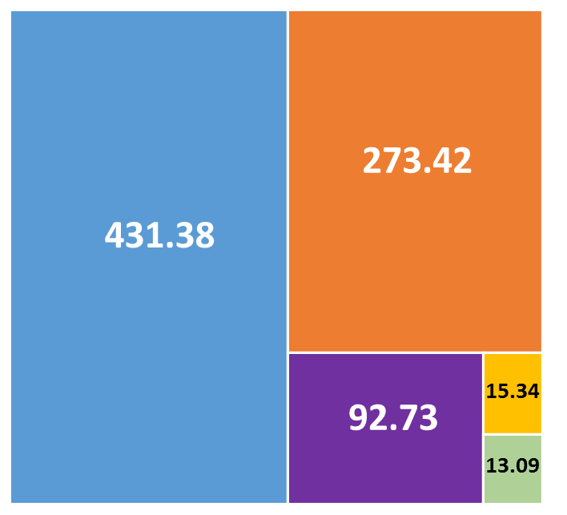
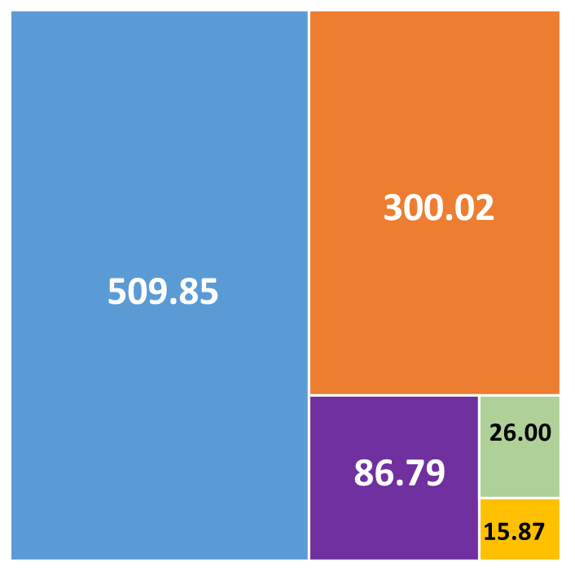
Expenditure and Sources
2016-17:
Rs. 825.96 cr
2017-18: Rs. 938.53
Direct Govt. Funding
Internal Resources
Govt. Research Grants
Support from alumni, other donors, CSR
Non-govt. Research Grants and Scholarships, Chairs, Consultancy, etc.
Amounts in Rs. Crores

Slide 20
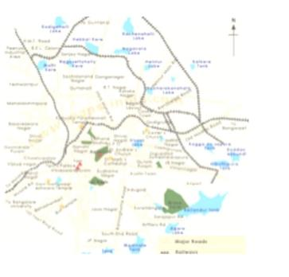
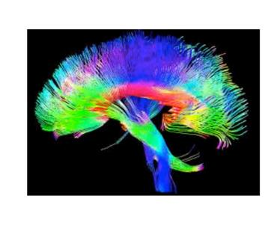
Private Support of Large Programs
Rs. 115 crores over 10 years
Robert Bosch Foundation
US $3 million
Mr. Arjun Divecha &
The Grantham Foundation
DIVECHA CENTRE FOR
CLIMATE CHANGE
Rs. 225 crores over 10 years
Mr. Kris and Mrs. Sudha Gopalakrishnan (Infosys)
Rs. 75 crores over 5 years
Tata
Trusts
IMAGING the BRAIN

Slide 21
IISc: Research Productivity
33,427
Web of Science Documents
573,853
No. of Citations
209
H-index
12,000
PUBLICATIONS in top
journals and conferences
in the last 5 years
400
PhDs graduated in 2017-18
Getting close to
1 PhD/Faculty member per year

Slide 22
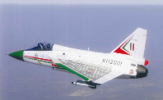
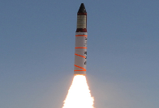
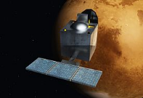
Role in Nation Building
Contributions to National Programs
Building Institutions
Light Combat Aircraft Aerodynamics modelling, fibre-optic-sensors systems for SHM & head-up display
Missile Development Programme
Testing of hypersonic vehicle and missiles, and developing detector-cooler systems
CPRI
IIT KGP
Mars Orbiter Mission
Indigenous calibration and testing of pressure and level sensors for cryogenic engines
JNCASR
Notes:
Positioning IISC as a global Institution was the vision and mandate set by our founder and this vision and target guides us today too

Slide 23
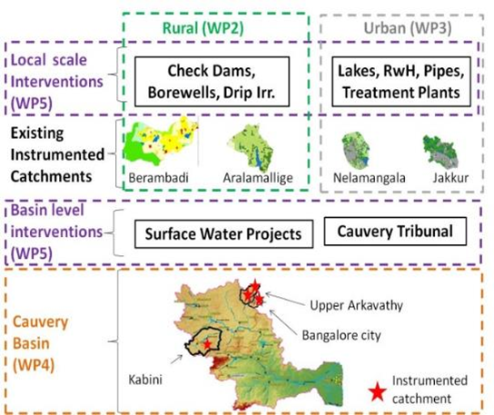
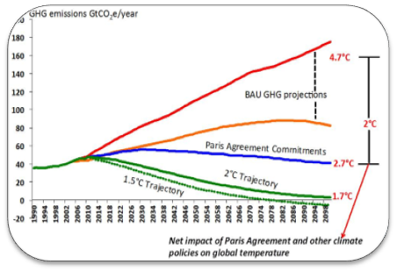
National Capability Building (some examples)
Hypersonic Platform Technologies
(with Brahmos Aerospace)
Gallium Nitride process and devices
Climate Change policy
Basin-Scale Water Management

Slide 24
Faculty Awards & Honours
National Awards (cumulative, since founding)
International Honours
(among serving faculty)
5
Infosys Prize Winners
Bharat Ratna
(2)
Padma Vibhushan
(3)
Padma Bhushan
(14)
Padma Shri
(18)
SS Bhatnagar Prize
(95)
9
IEEE Fellows
National Fellowships (among serving faculty)
30
Fellows of The World Academy of Sciences
Swarnajayanthi Fellowship Awards (31)
6
Editors-in-chief of international journals
J. C. Bose National Fellows
(68)
Indian Academy
of Sciences
(102)
Indian National Science Academy (91)
National Academy of Sciences, India (74)
Indian National Academy of Engineering (59)
Editors of international journals
3 ACM, 6 ACS, 4 ASME, 17 IEEE, 9 IOP, 17 Nature, 4 PLOS, 5 RSC
217
Highest Number of National and International Awards and Recognitions, and Research Publications for any Academic Institution in India

Slide 25
IISc: Strengths, uniqueness, best practices

Slide 26
Strengths & Uniqueness
Equal emphasis on the sciences and on engineering since the very beginning
Culture of fundamental investigations
IISc has nurtured curiosity driven research in all areas
Independence to pursue individual research goals
Driving interdisciplinary research
A new division created with centers focused on solving pressing societal problems
Nano-science and engineering, water, energy, climate, transportation, smart socio-technical systems
65% of the students are enrolled in PhD programs
Research oriented masters’ and UG programs

Slide 27
Strengths & Uniqueness
Best practices in faculty recruitment
High expectations from the faculty
Promotions through rigorous international peer review
Constantly introducing best practices and novel programs
Tenure system for faculty
High value start-up grants
Interdisciplinary PhD programs
Faculty entrepreneurship program initiated as early as 2003
Young Investigator (YI) positions
Additional salary and research grants for YIs

Slide 28
Significant Practices@IISc: Faculty
Faculty recruitment
3 level scrutiny
Personal interaction with dept. and related faculty, over one or two days
Short-listed applicants meet the divisional chair (similar to an IIT Dean), and possibly the Director
Interview (in person or over video conference), with external experts on the panel
Reference letters: very important role
Monitoring and mentoring
On entry, 1 year, 3 years, and peer review at 6 years
Enablement via start-up grant, and PhD students on entry
Tenure system has been introduced
All Assistant Professors are on contract
Must get promoted by peer review within 7 years, to acquire “tenure”
Standing Promotion and Assessment Committee of external senior experts
All peer review material placed before PAC for final decision

Slide 29
Significant Practices@IISc: Research
Equal strengths in science and engineering
Right from the first two departments in 1909
Strong sense of interdisciplinarity
Emphasis on fundamental investigations
Intellectual independence
Over Rs. 300 crores sponsored research annually
Based on research proposals made by faculty members
Contributions to national programs
Power, space, defence, telecom, climate change, vaccination, materials, nanotechnology, etc.
PhDs and peer reviewed publications: the main outputs
350-400 PhDs are completing annually
Rigorous training of PhDs
Publications in some of the best journals and conferences
Emphasis on quality and peer review

Slide 30
Significant Practices@IISc: Industry and Innovation
Society for Innovation and Development
Runs a research and incubation “park”
Large “umbrella” research projects from the industry
General Motors, Boeing
Co-innovation laboratories
Tata Motors, Pratt and Whitney, TCS (new)
Entrepreneurship (faculty/student “start-ups”)
27 start-ups since 2000
2000-2015: 17 start-ups, of which 9 are making revenues
Centre for Scientific and Industrial Consultancy
About Rs. 10 crores of activity per year
Industry funded applied research centres in IISc
BMTC, Divecha, Robert Bosch, Tata Trusts, Pratiksha Trust
Annual grants or endowments

Slide 31
Significant Practices@IISc: Course-Work and Teaching Teachers
Taking courses exposes students to several faculty members
Diversity of thinking and points of view
Systematic learning of theory and techniques that helps students diversify
Else, the PhD guide is just producing clones
Teaching the teachers
An important social service that top institutions in the country might have to perform
Challenge of inducting faculty members for such activities

Slide 32
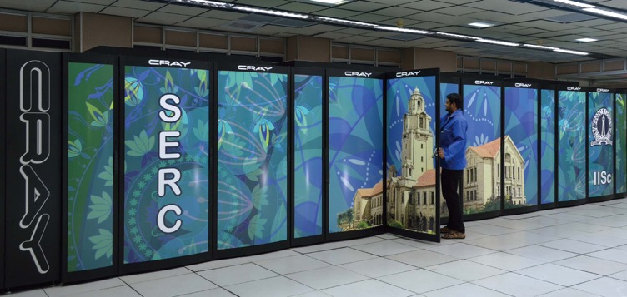
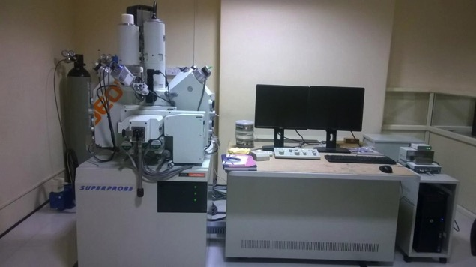
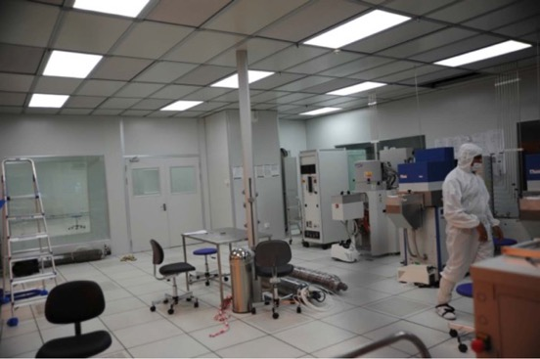
Advanced Research Facilities
SahasraT (Cray XC40) Petaflop Computer
Advanced Facility for Microscopy and Microanalysis
AV400 - Bruker 400 MHz
ECX400 - Jeol 400 MHz for solids
AV500 - Bruker 500 MHz
ECX500 - Jeol 500 MHz
AV500S - Bruker 500 MHz for solids
AV700 - Bruker 700 MHz with cryo probe
AV800 - Bruker 800 MHz with cryo probe
CeNSE National NanoFab
NMR Centre: Multiple NMR Spectrometers

Slide 33
IISc Challakere: Science For Society
1,500 acres sprawling landscape, 200 Km from Bengaluru
As part of an 8000 acres Science City Project of Government of Karnataka
IISc’s neighbours here include national institutions such as DRDO, BARC & ISRO
IISc PROJECTS:
Skill development centre and associated laboratories and housing
Climate change observatory
Large test-beds for solar energy
Extension centre of the Centre for Sustainable Technologies

Slide 34
Some Good Practices Around the World

Slide 35
US Academia: Major contributions to national and industry problems
Development of microwave radar (at MIT, 1940-45)
“It is frequently said that, although the atomic bomb ended World War II, it was radar that won the war.”
Polio vaccine (1952)
Post-war baby boom; 10s of 1000s of children contract polio
Enders, Weller, & Robbins, Harvard Medical School (1954 Nobel)
Led to the successful Jonas Salk vaccine
SPICE simulator for electronic circuits (UC Berkeley, 1973)
Later commercialised through Synopsys and Cadence
IBM Watson’s QA technology (2011)
CMU, along with MIT, UTA, USC, RPI, U Albany, U Trento, U Mass
… and many others

Slide 36
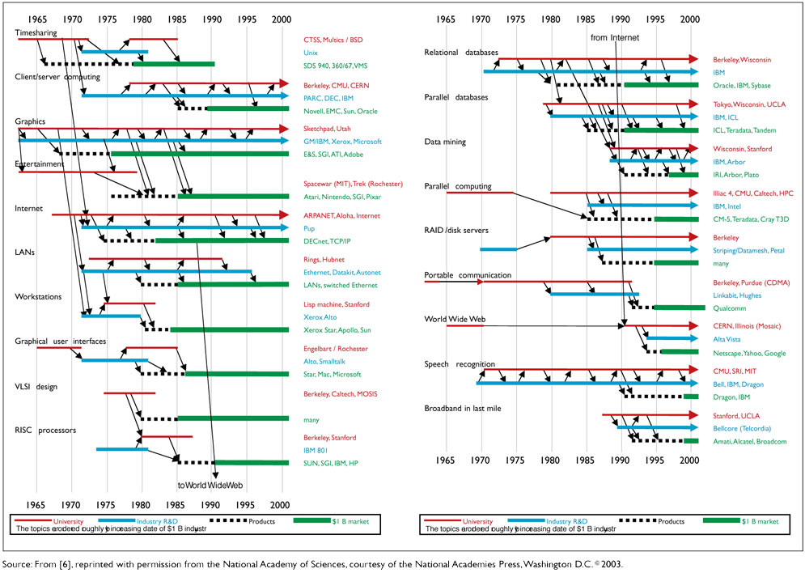
Academia-Industry: Not just one-way traffic
Shankar Sastry, Pan IIT 2014

Slide 37
The Impact Of Academic Research On Industrial Performance US National Academy of Engineering, 2003
“American universities are integral to the success of American industry. The core mission of the university, educating much of the American workforce, is essential to productivity growth, innovation, technological progress, and virtually every other national economic and societal objective. Academic research—in physical sciences, social sciences, computer sciences, and engineering—provides a constant flow of ideas, analyses, and breakthroughs that vitalize industry. The strengths of academic research—principally the resources to focus on long-term, fundamental, risky goals and to mount broad collaborative projects—complement the applied research and development (R&D) performed by industry. Universities are a source not only of scientific and technological ideas that lead to new products and processes, but also social and political insights that strengthen the nation’s ability to adapt to new technologies and, therefore, to embrace continued innovation. As industries have become more dependent on innovation, new skills, and technological prowess, academic contributions have become increasingly critical to economic success.”

Slide 38
Integrating Discovery Research and Innovation
I want to have impact while conducting basic research; how is that possible here?
Basic Research
Applied Research
Stokes’s Model
The Discovery-Innovation Cycle
Curiosity driven basic research (Bohr’s Quadrant) | Use inspired basic research (Pasteur’s Quadrant)
 | Applications development without recourse to fundamental investigations (Edison’s Quadrant)
Discovery Research
Quest for fundamental understanding
Fundamental questions
Fundamentals driven solutions
Need Driven Innovation
Considerations of use
Narayanamurti and Odumosu, “Cycles of Invention and Discovery: Rethinking the Endless Frontier,” Harvard, 2016
Donald Stokes, “Pasteur’s Quadrant: Basic Science and Technological Innovation,” Brookings, 1997

Slide 39
The Importance of Collaboration
Complementary expertise
Leveraging resources
Increasing importance of interdisciplinarity
The only way to do “big” impactful problems
Citations/paper vs. number of authors

Slide 40
Challenges of Our Ecosystem

Slide 41
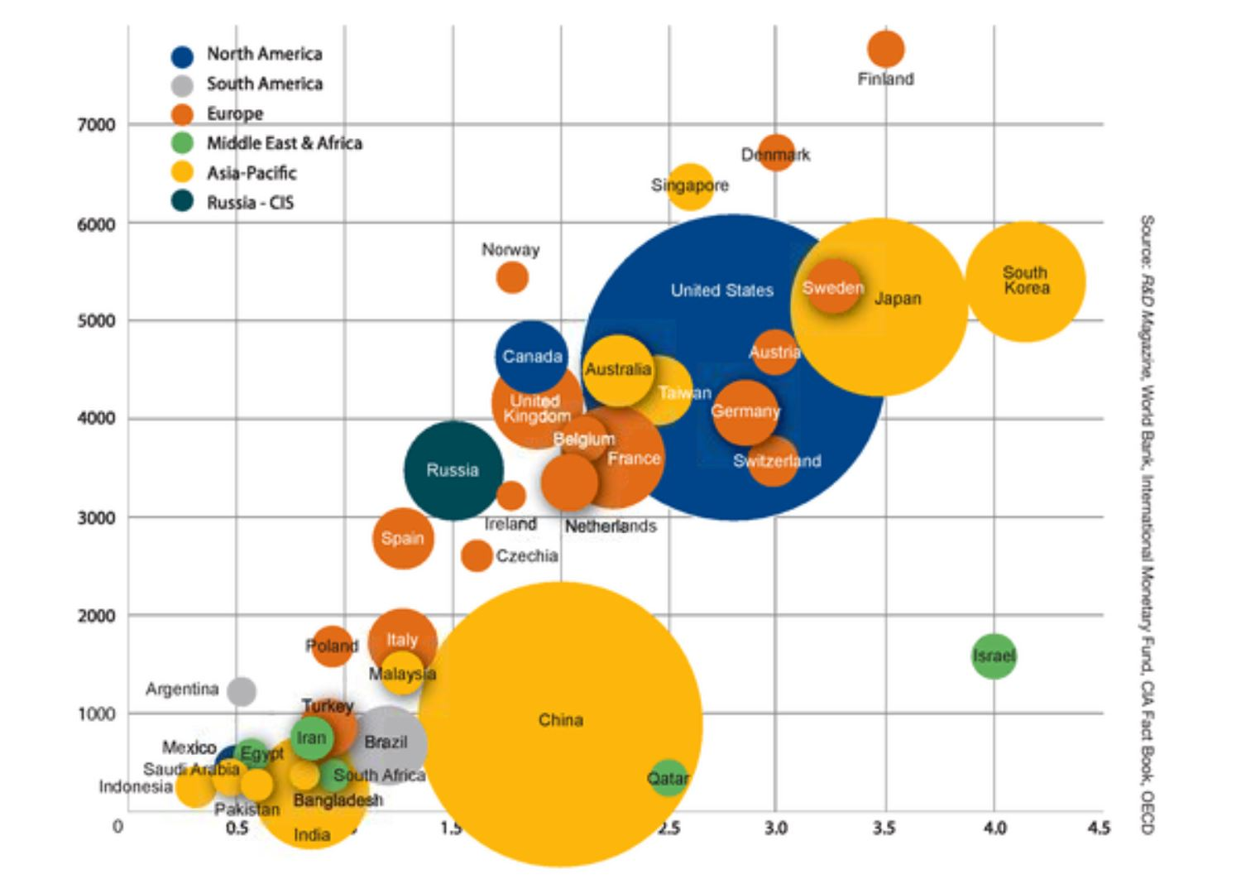
Research Funding Around the World
2014
2018

Slide 42
Battelle; R&D Mag

Slide 43
No. of Researchers and R&D Spending
Country | Researchers per Million Population | Population (mn) | R&D Spending ($ bn. PPP)
India | 156 | 1322 | 48
China | 1113 | 1387 | 370
USA | 4231 | 326 | 479
Japan | 5386 | 127 | 171
China’s 7 times larger R&D expenditure is supported by a 7 times large R&D workforce
India seems to be limited by a shortage of R&D manpower
Small increases in R&D spending have been shown to substantially increase GDP growth
http://uis.unesco.org/apps/visualisations/research-and-development-spending/

Slide 44
What Should be our “Research Mix” in India?
Research Priorities and Institutional Performance
Basic research: publications, citations
Impact on scientific reputation and rankings
Applied and translational research
Driven by basic/foundational research
Patents, start-ups
Impact on industry/society
Battelle; R&D Mag

Slide 45
Boundaries of Our Own Creation
Basic vs. applied
Theoretical vs. experimental
Core vs. interdisciplinary
Deep vs. broad
Individual vs. collaborative
Science vs. technology
Discussion in an IISc Joint Faculty Meeting
“institutions like IISc must have room for many different kinds of faculty members: “prolific publishers” (those who publish frequently), “deep thinkers” (those who strive to dig deeper and publish only a few papers, but of very high quality), “the big-fish hunters” (those who take the high-risk path of going after the big problems), “national-impact professors” (those who work towards fulfilling national needs), and “system builders” (those who build systems that help design and create innovations)”
(Prof. P. Vijay Kumar, ECE, transcript of speech in the JFM)
Indeed during a career an individual can pass through one or more of these phases

Slide 46
Decision-Making Based on Media Rankings
Our context is different from US universities
Internationalisation and diversity: should the passport matter?
The metric of foreign faculty and foreign students only cares about the passport that the person carries
So a university with mostly home-grown faculty, and some (mediocre) foreign faculty members gets high marks
Top Indian institutions recruit high quality faculty, most of whom have international research training
Some of the best students from a very large, and ethnically diverse, national pool study at these universities
Unlike the US, where the home population is often not interested in STEM careers
Let’s focus on strengthening the hard academics, research, impact, and innovation metrics
Read “internationalization” as “international visibility and international collaboration”
Which requires travel support and hospitality infrastructure
Some international faculty and students would add diversity and help temper the “home comfort” factor

Slide 47
Strengthening our International Outlook
International contact important to stay current, to publicise our research, and build reputation
Directly impacts some of the rankings
Faculty and student travel funding is very limited
Funds for hosting foreign faculty and foreign students are needed
Need a program of international fellowships for inviting and hosting foreign scholars

Slide 48
Internationalisation Needs World-Class Campuses
Many US campuses are in dangerous areas
“Don't walk around after dark, travel in a group if you do, and be careful of making a wrong turn outside of the campus.”
Many-many US campuses are in uninteresting locations with nothing really to do outside the campus
West Lafayette, College Station, Urbana, etc.
Yet these campuses continue to attract the best students and faculty from around the world
The campus itself is a beautiful, well-built, well-maintained, hygienic, self-contained, safe and secure, intellectually stimulating, culturally rich, fun-to-be-in community, with a lot of intellectual flow
Many of our Institutes have very large campuses that can easily be world-class magnets for international researchers, if there are funds and freedom to develop them as such
Every experience of anyone visiting these campuses must be world-class
No power failures; high quality buildings; top-class research infrastructure…

Slide 49
Evaluation Criteria
People shape their working styles to conform to evaluation criteria
Evaluation criteria in Indian academia are heavily geared towards to just “counts”
Publication counts, PhD student counts, number of invited lectures, etc.
… and individual contributions
Lead authorship, group leadership, etc.
Such criteria also pervade the selection processes for academy fellowships, awards, and other recognitions
Hence, faculty simply work towards piling up the counts
Often not trying something new and risky, as it might interrupt the flow
Avoid setting up collaborations in an increasing interdisciplinary world
Need to assess impact rather than volume
Not easy to do
Need to look at best practices

Slide 50
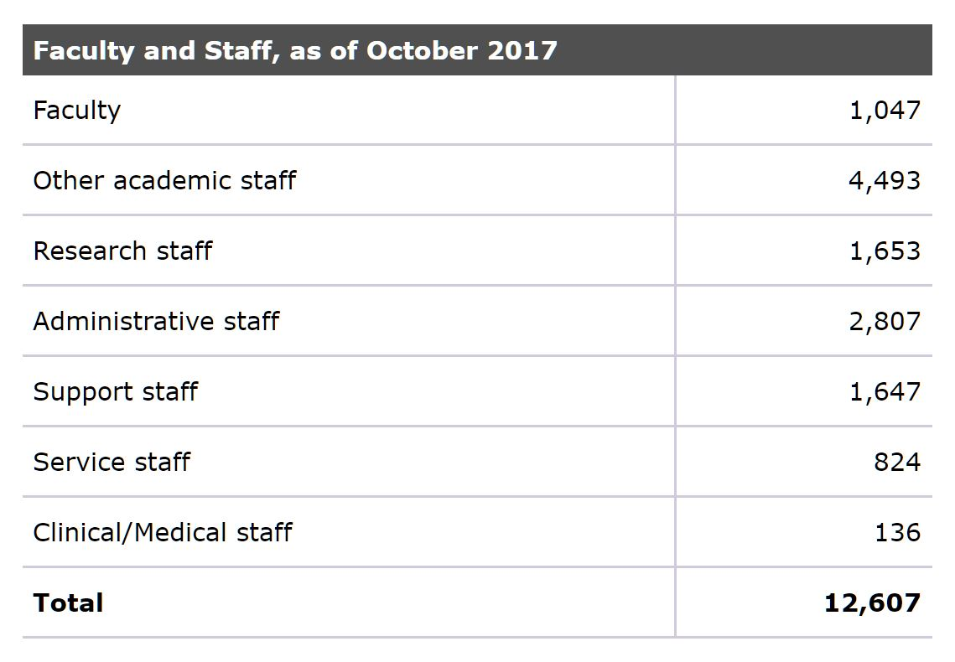
Making Good Use of Faculty Time
MIT
Caltech faculty and staff (website)
300 faculty members
3900 supporting staff
There appears to be a very large ratio between support staff and faculty in these institutes
Are our faculty being adequately supported?
Are our administrative systems themselves world class?
How do we give top class faculty the uninterrupted, deep thinking time that they need, and support their work in the best possible way?
200 strong fund raising office, currently engaged in a campaign to raise $5 billion

Slide 51
Meeting these Challenges@IISc: Fund Raising
In 2015, the Office of Development and Alumni Affairs (ODAA) was created
Two Development Officers were recruited
ODAA has succeeded in raising about Rs. 200 crores of commitments over this period
resulting in an annual revenue flow of about Rs. 25 crores to IISc
The alumni have often played important roles in getting the connections to donors

Slide 52
Meeting these Challenges@IISc
Internationalisation
IISc has had an Office of International Relations (OIR) for many years
In 2015 OIR was strengthened with an International Relations Officer; there are two now
IISc admits foreign students; there are also Joint PhD Supervision programs
Under the IoE scheme several internationalization programs have been launched
Professional admin support
Recruited professionals on contract
DIGITS: campus digitalization, networking, and IT management: IT Officers
ODAA: fund raising and alumni affairs: Development and Alumni Affairs Officers
OIR: International Relations Officers
OCCaP: Office of Career Counselling and Placement: Placement Officer
OLSEH: Office of Laboratory Safety and Environmental Health: Safety Officers

Slide 53
Conclusion
Must aim for 5-10 universities in the top 100 in the world in the next 10 years
Need to think local & global, and act local & global
The compulsions of a developing economy
Universities are at different stages of evolution
They need to achieve excellence phase-wise
Very little internal discussion on domestic problems
The pool of researchers must increase
The university-government-industry-society connection is weak
Need a culture of excellence

