Slide 1
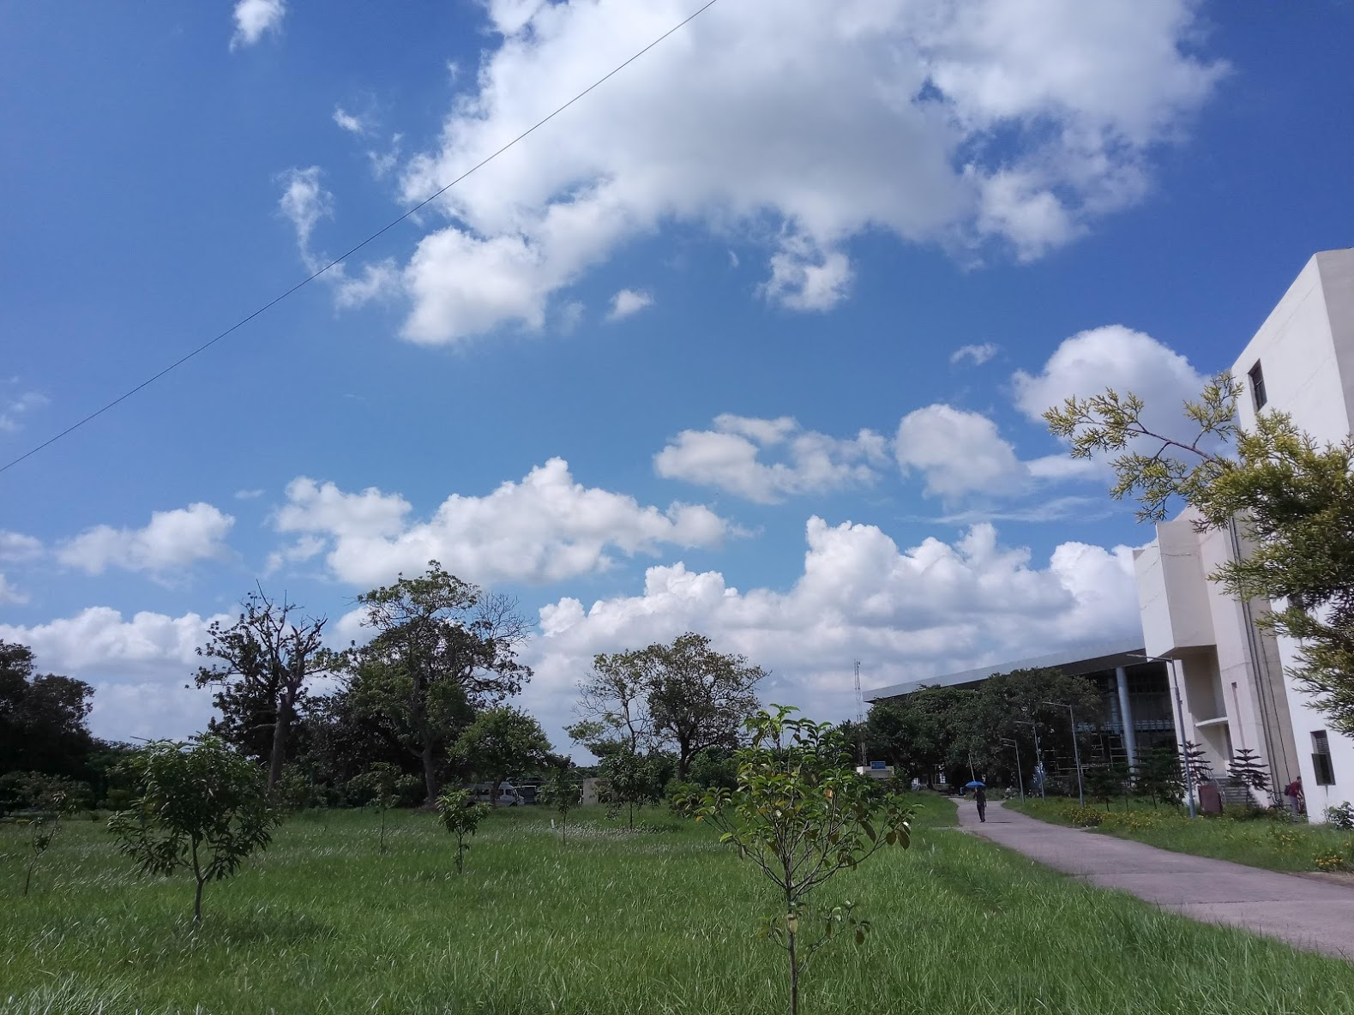

Indian Institute of Science Education and Research Kolkata
An Introduction

Slide 2
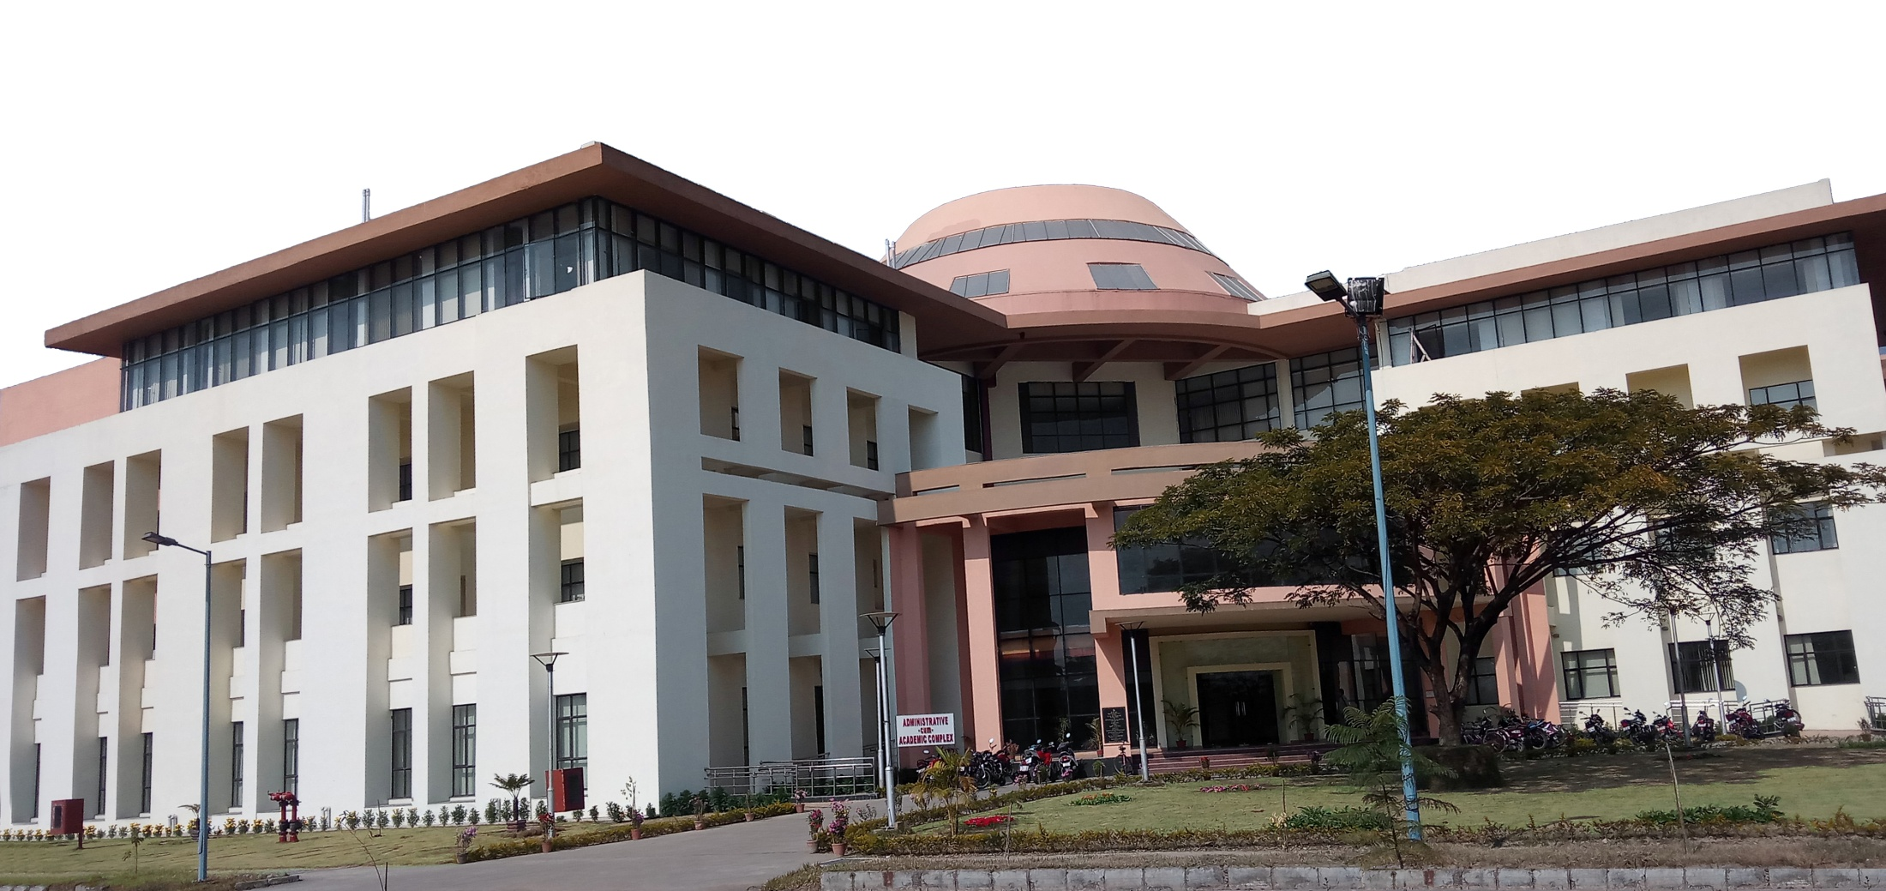
… towards Excellence in Science
Indian Institute of Science Education and Research Kolkata

Slide 3
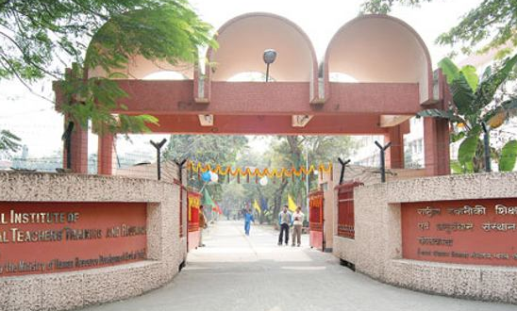
Fou
Founded in June 2006
IIT Kharagpur Extn. Centre and NITTTR, Kolkata (2006-2008)
First batch started in August 2006 with 38 students.

Slide 4
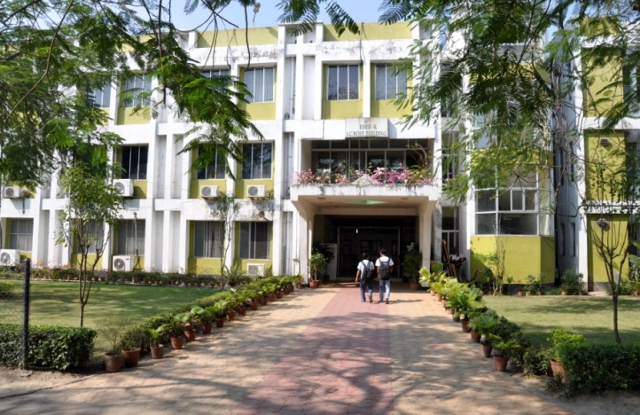
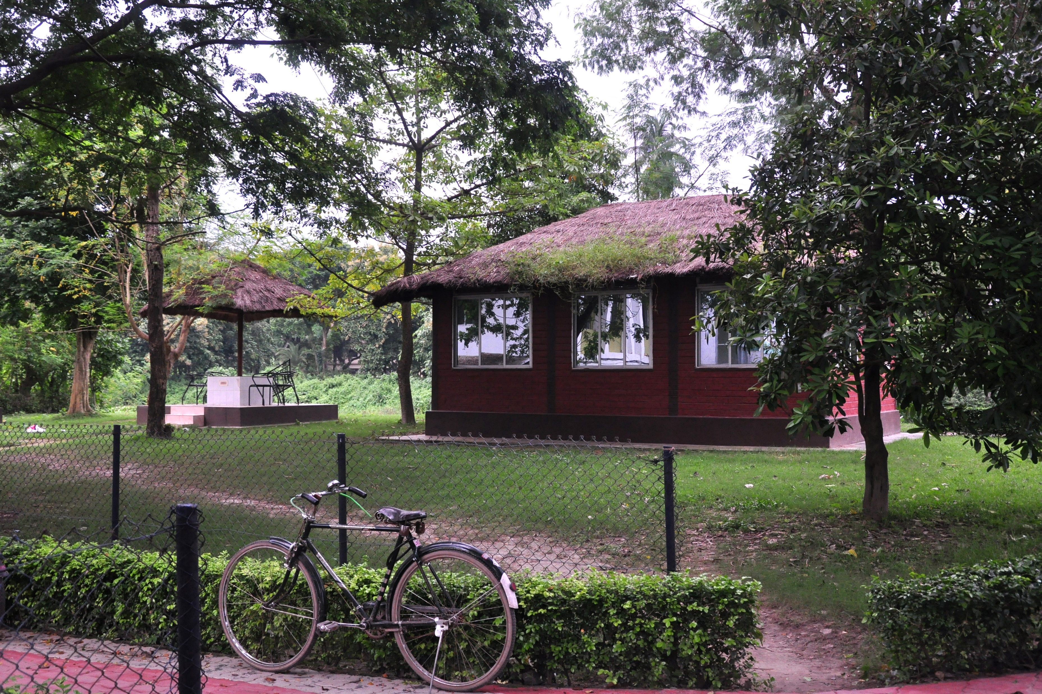
Transit Campus, Mohanpur
WBUAFS, BCKV and ARDD, Govt. of WB
2008 - 2013

Slide 5
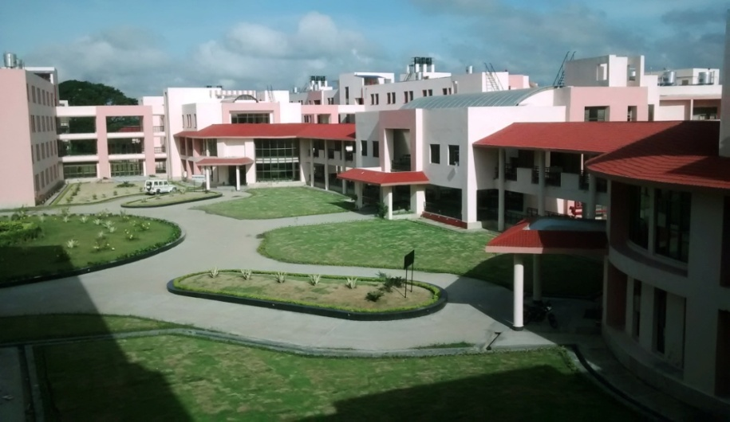
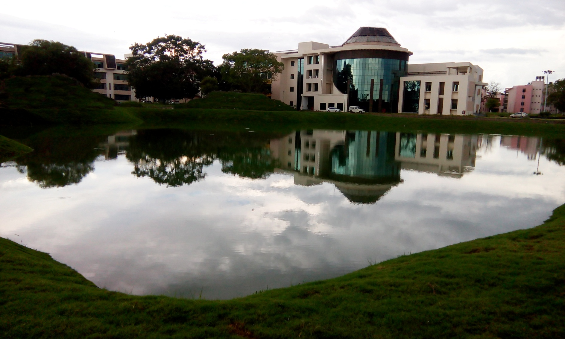
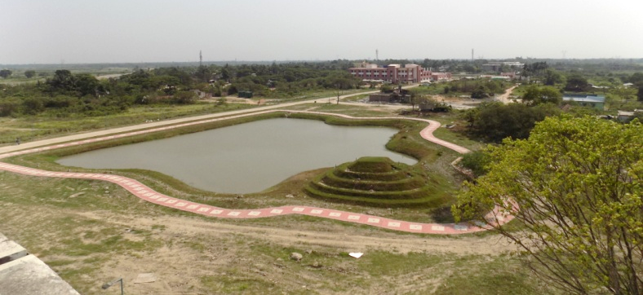
IISER Kolkata Campus
~201 acres

Slide 6
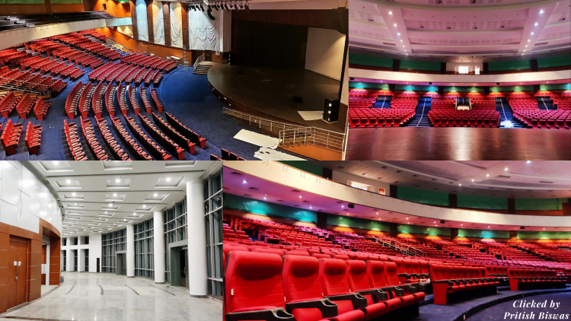
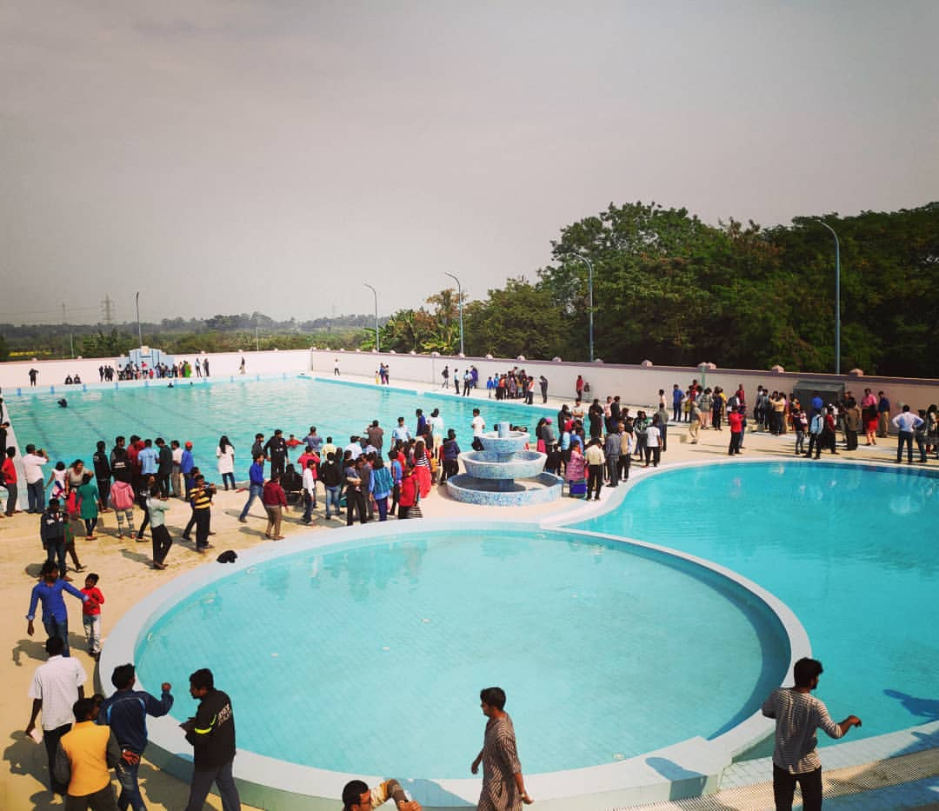
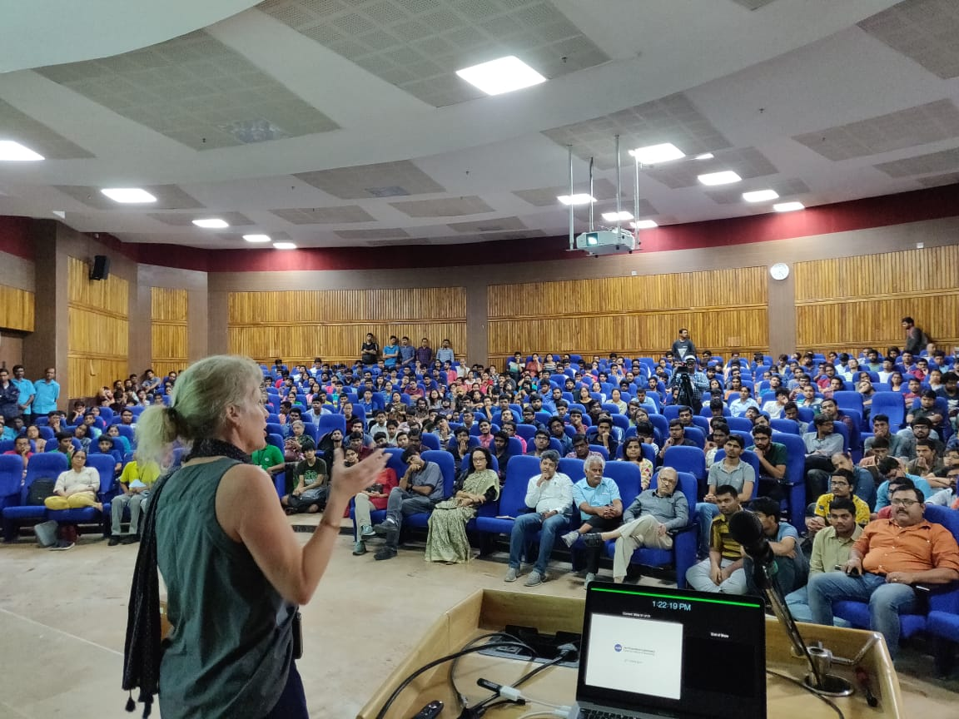

Slide 7
IISER Kolkata
From the atomic to the astronomical, with everything in between….
Biological Sciences
Earth Sciences
Center of Excellence in Space Sciences India (CESSI)
Core Departments
Chemical Sciences
Centre for Advanced Functional Materials (CAFM)
Mathematics and Statistics
Centres
Physical Sciences
National Centre for High Pressure Studies (NCHPS)
Newly Started >>
Center for Climate & Environmental Studies (CCES)
Department of Humanities & Social Sciences
Department of Computational and Data Sciences

Slide 8
IISER Kolkata – Some Achievements
Shanti Swarup Bhatnagar Prize – 2 in Chemical Sciences, 2018
Swarnajayanti Fellowship
INSA Young Scientist Award
Women’s Excellence Award
Fellowships of Academies
DBT-Wellcome Trust fellowship
Karen Harvey Prize
Janaki Ammal Award
National Geoscience Award
IISER Kolkata is an active participant in the LIGO consortium
Faculty have been elected to positions of responsibility in various national and international organizations
Students have received many national and international prizes

Slide 9
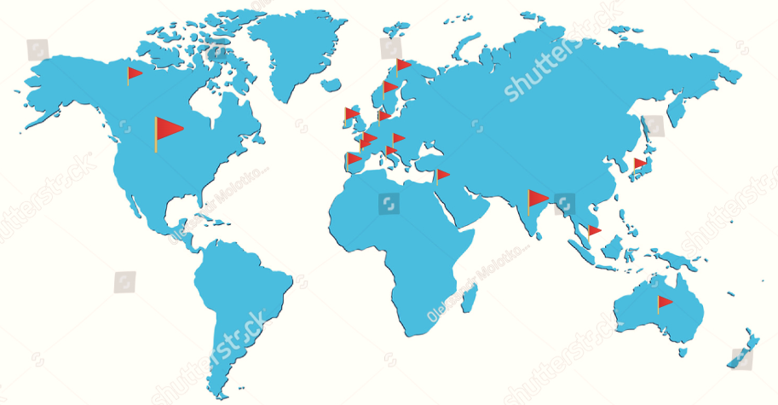
Global Footprint of IISER Kolkata

Slide 10
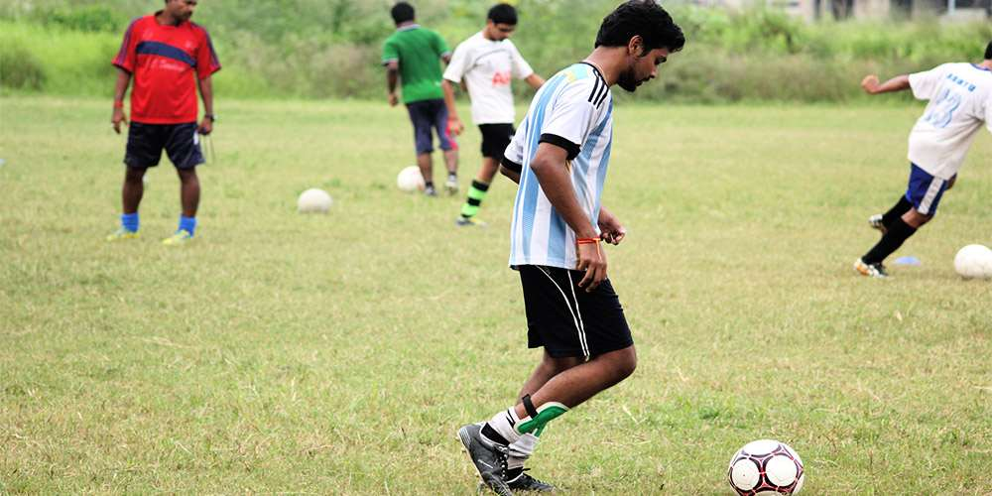
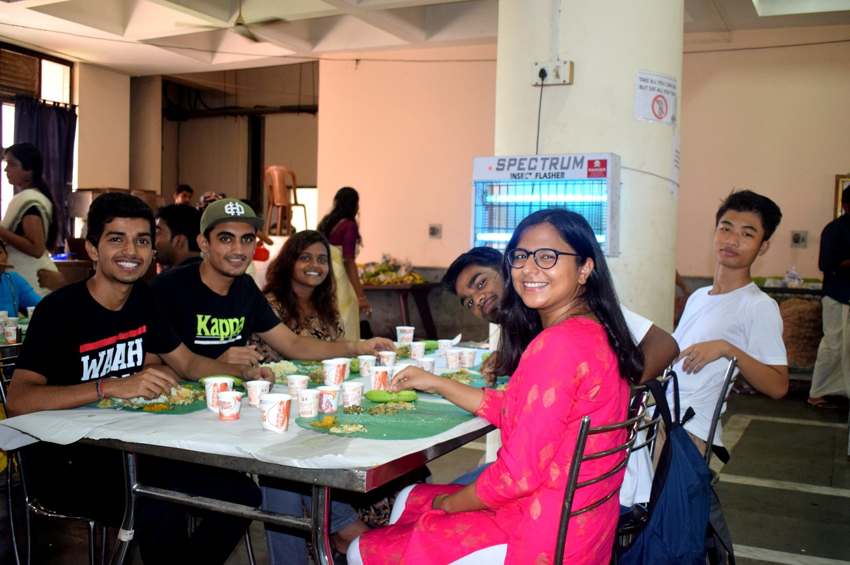

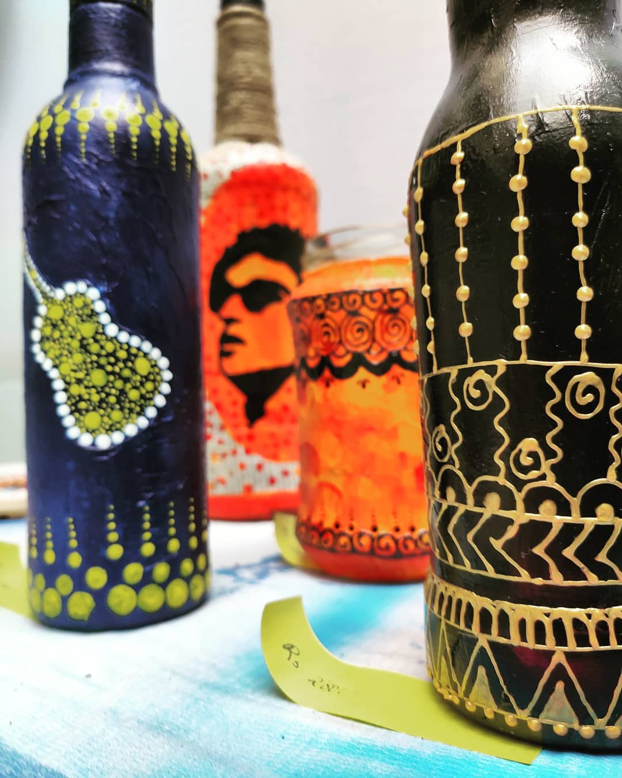
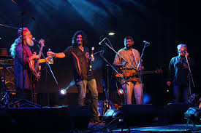
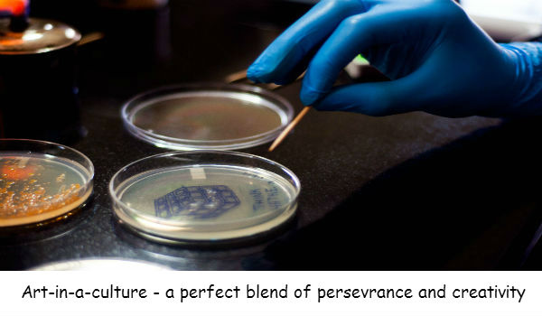
Life at IISER Kolkata – A Blend of Work and Play

Slide 11






Inquivesta – The first ever Science Fest of India

Slide 12
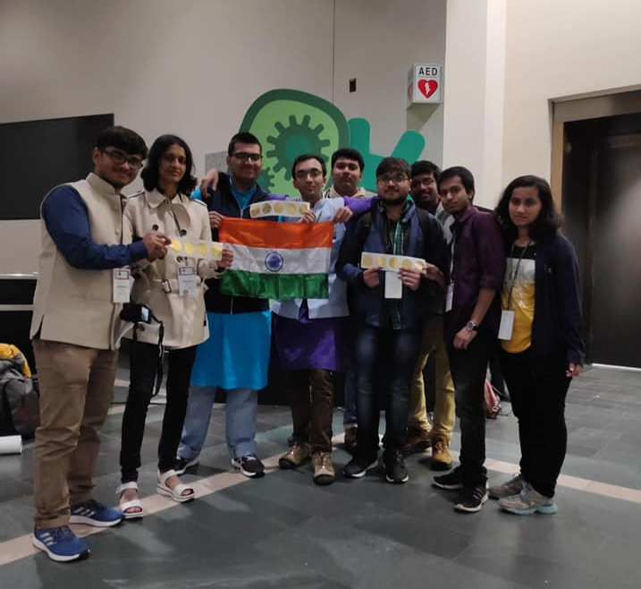
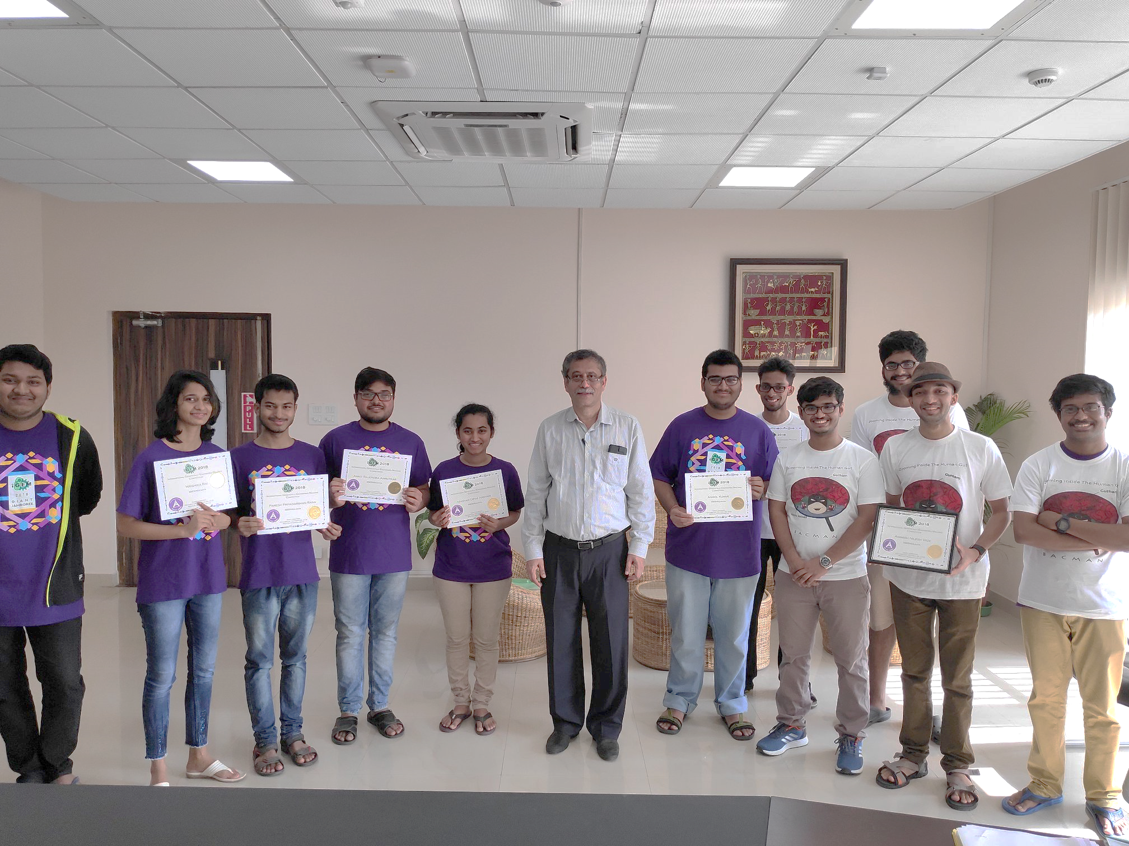
Our Students, Our Pride
First Time iGEMers bring home a Gold!
A gold a year, for the 3 years of participation.

Slide 13
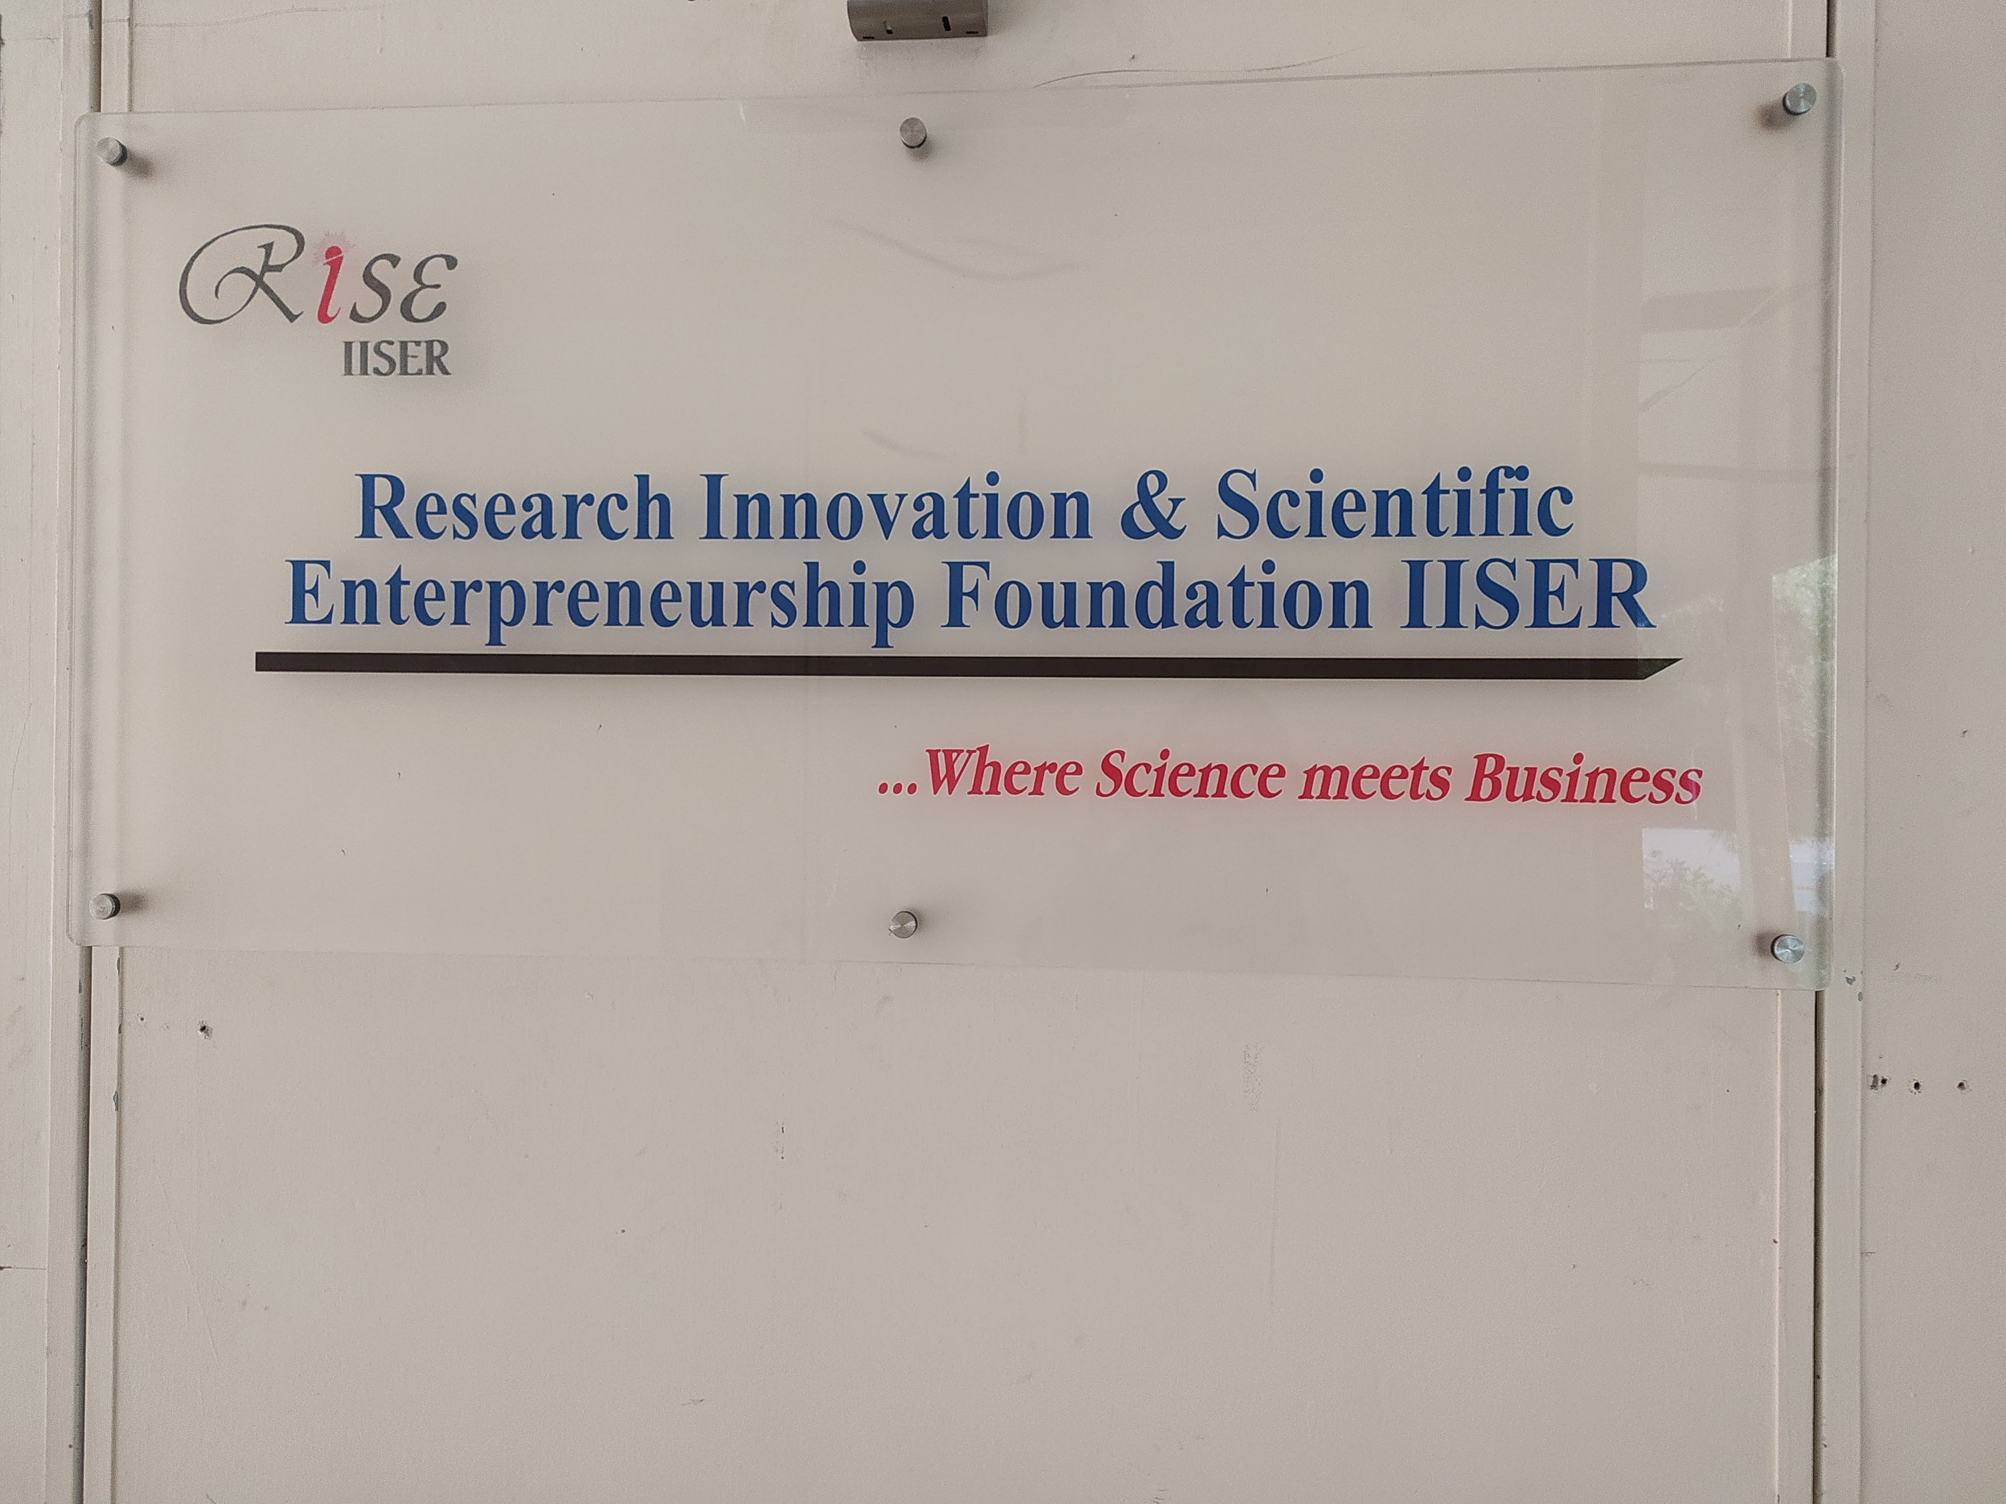
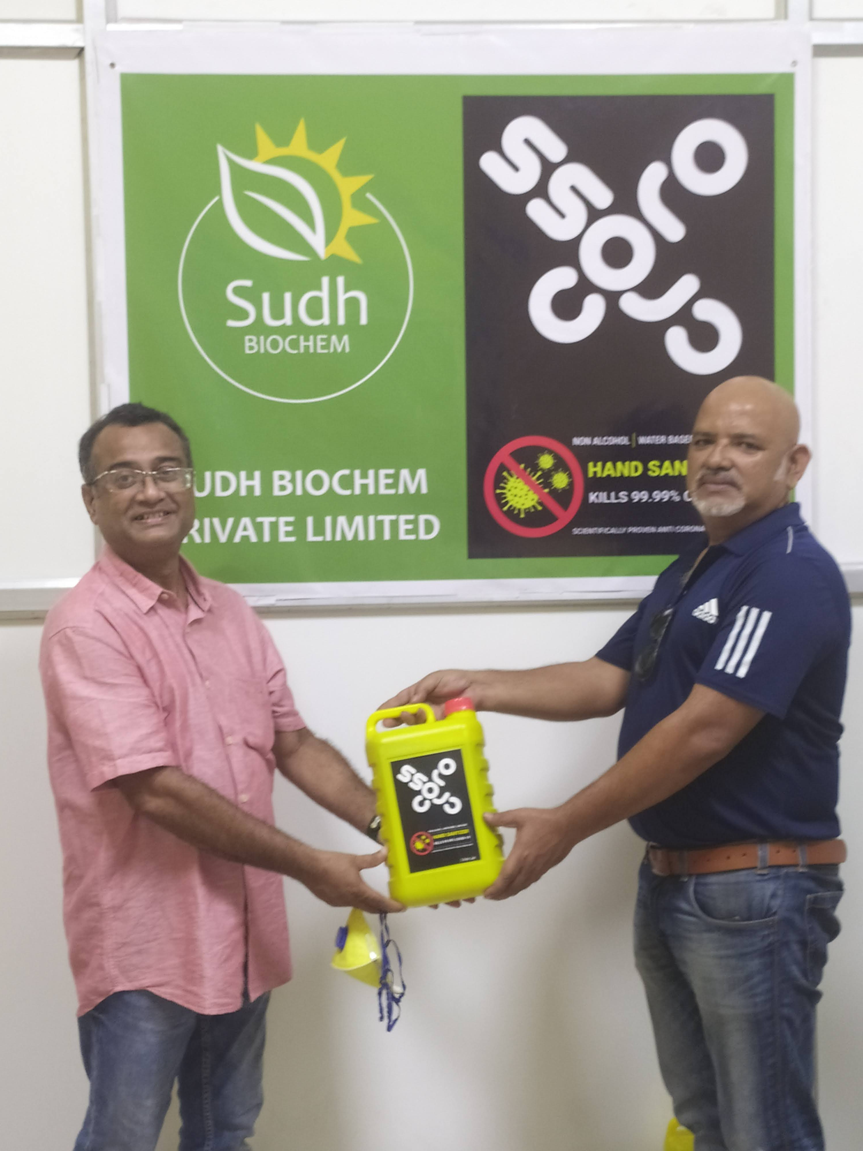
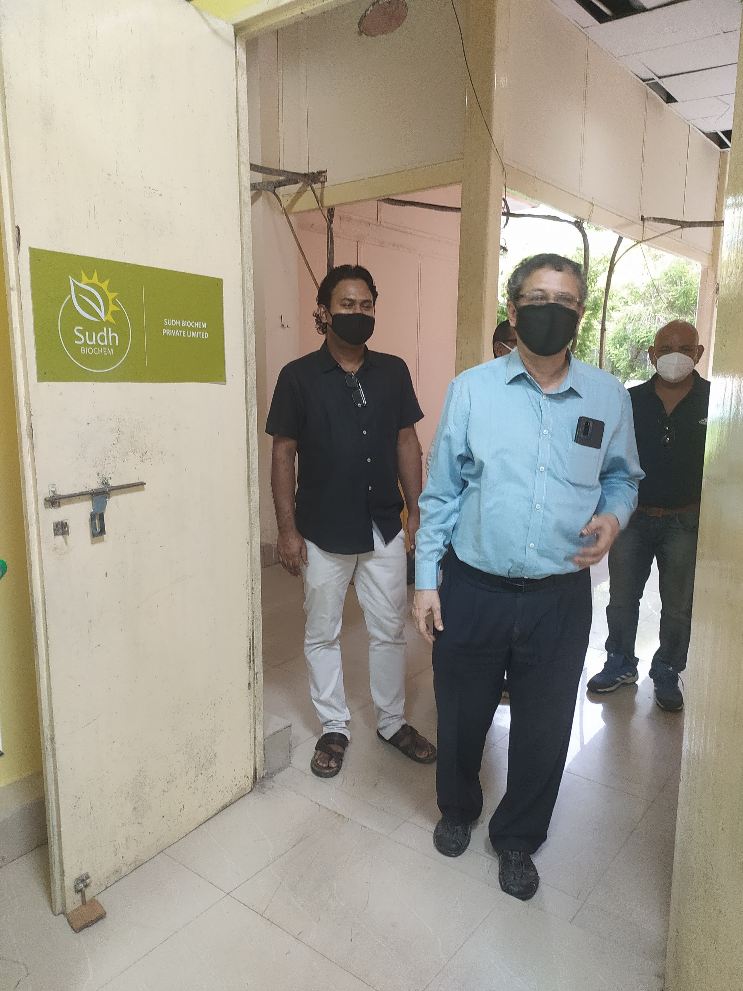
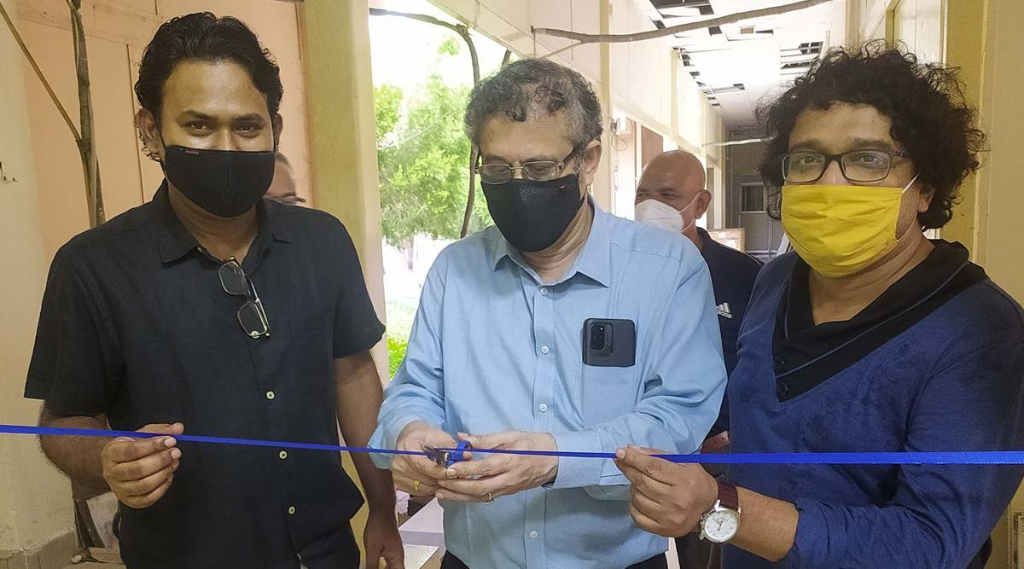
RISE Foundation IISER – Incubation Centre

Slide 14
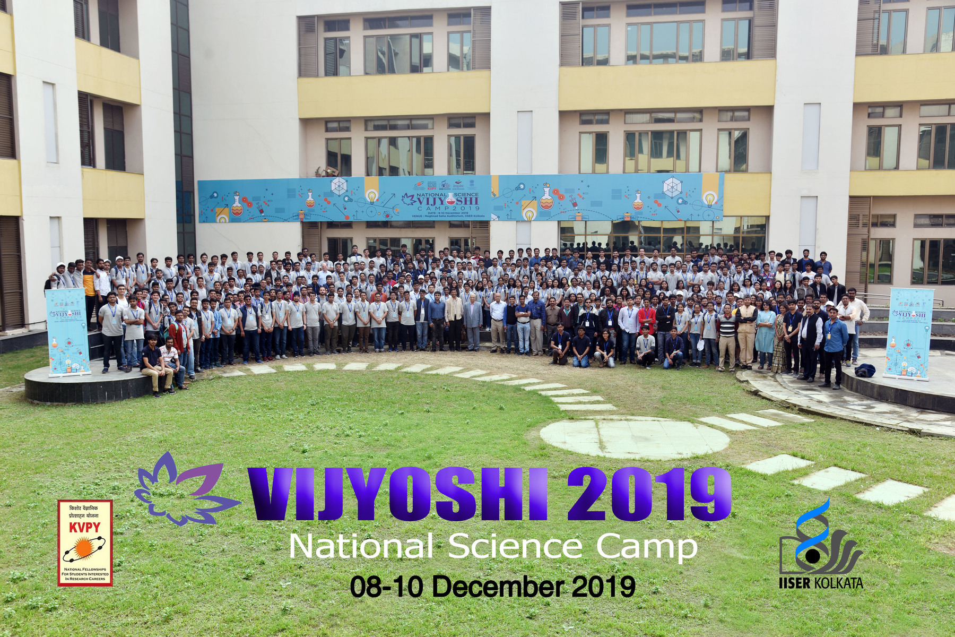
Outreach Programmes
Vijyoshi Camp
Ishan Vikas Programme
National Science Camp
Institute Open Day
Rashtriya Aviskar Abhiyaan

Slide 15
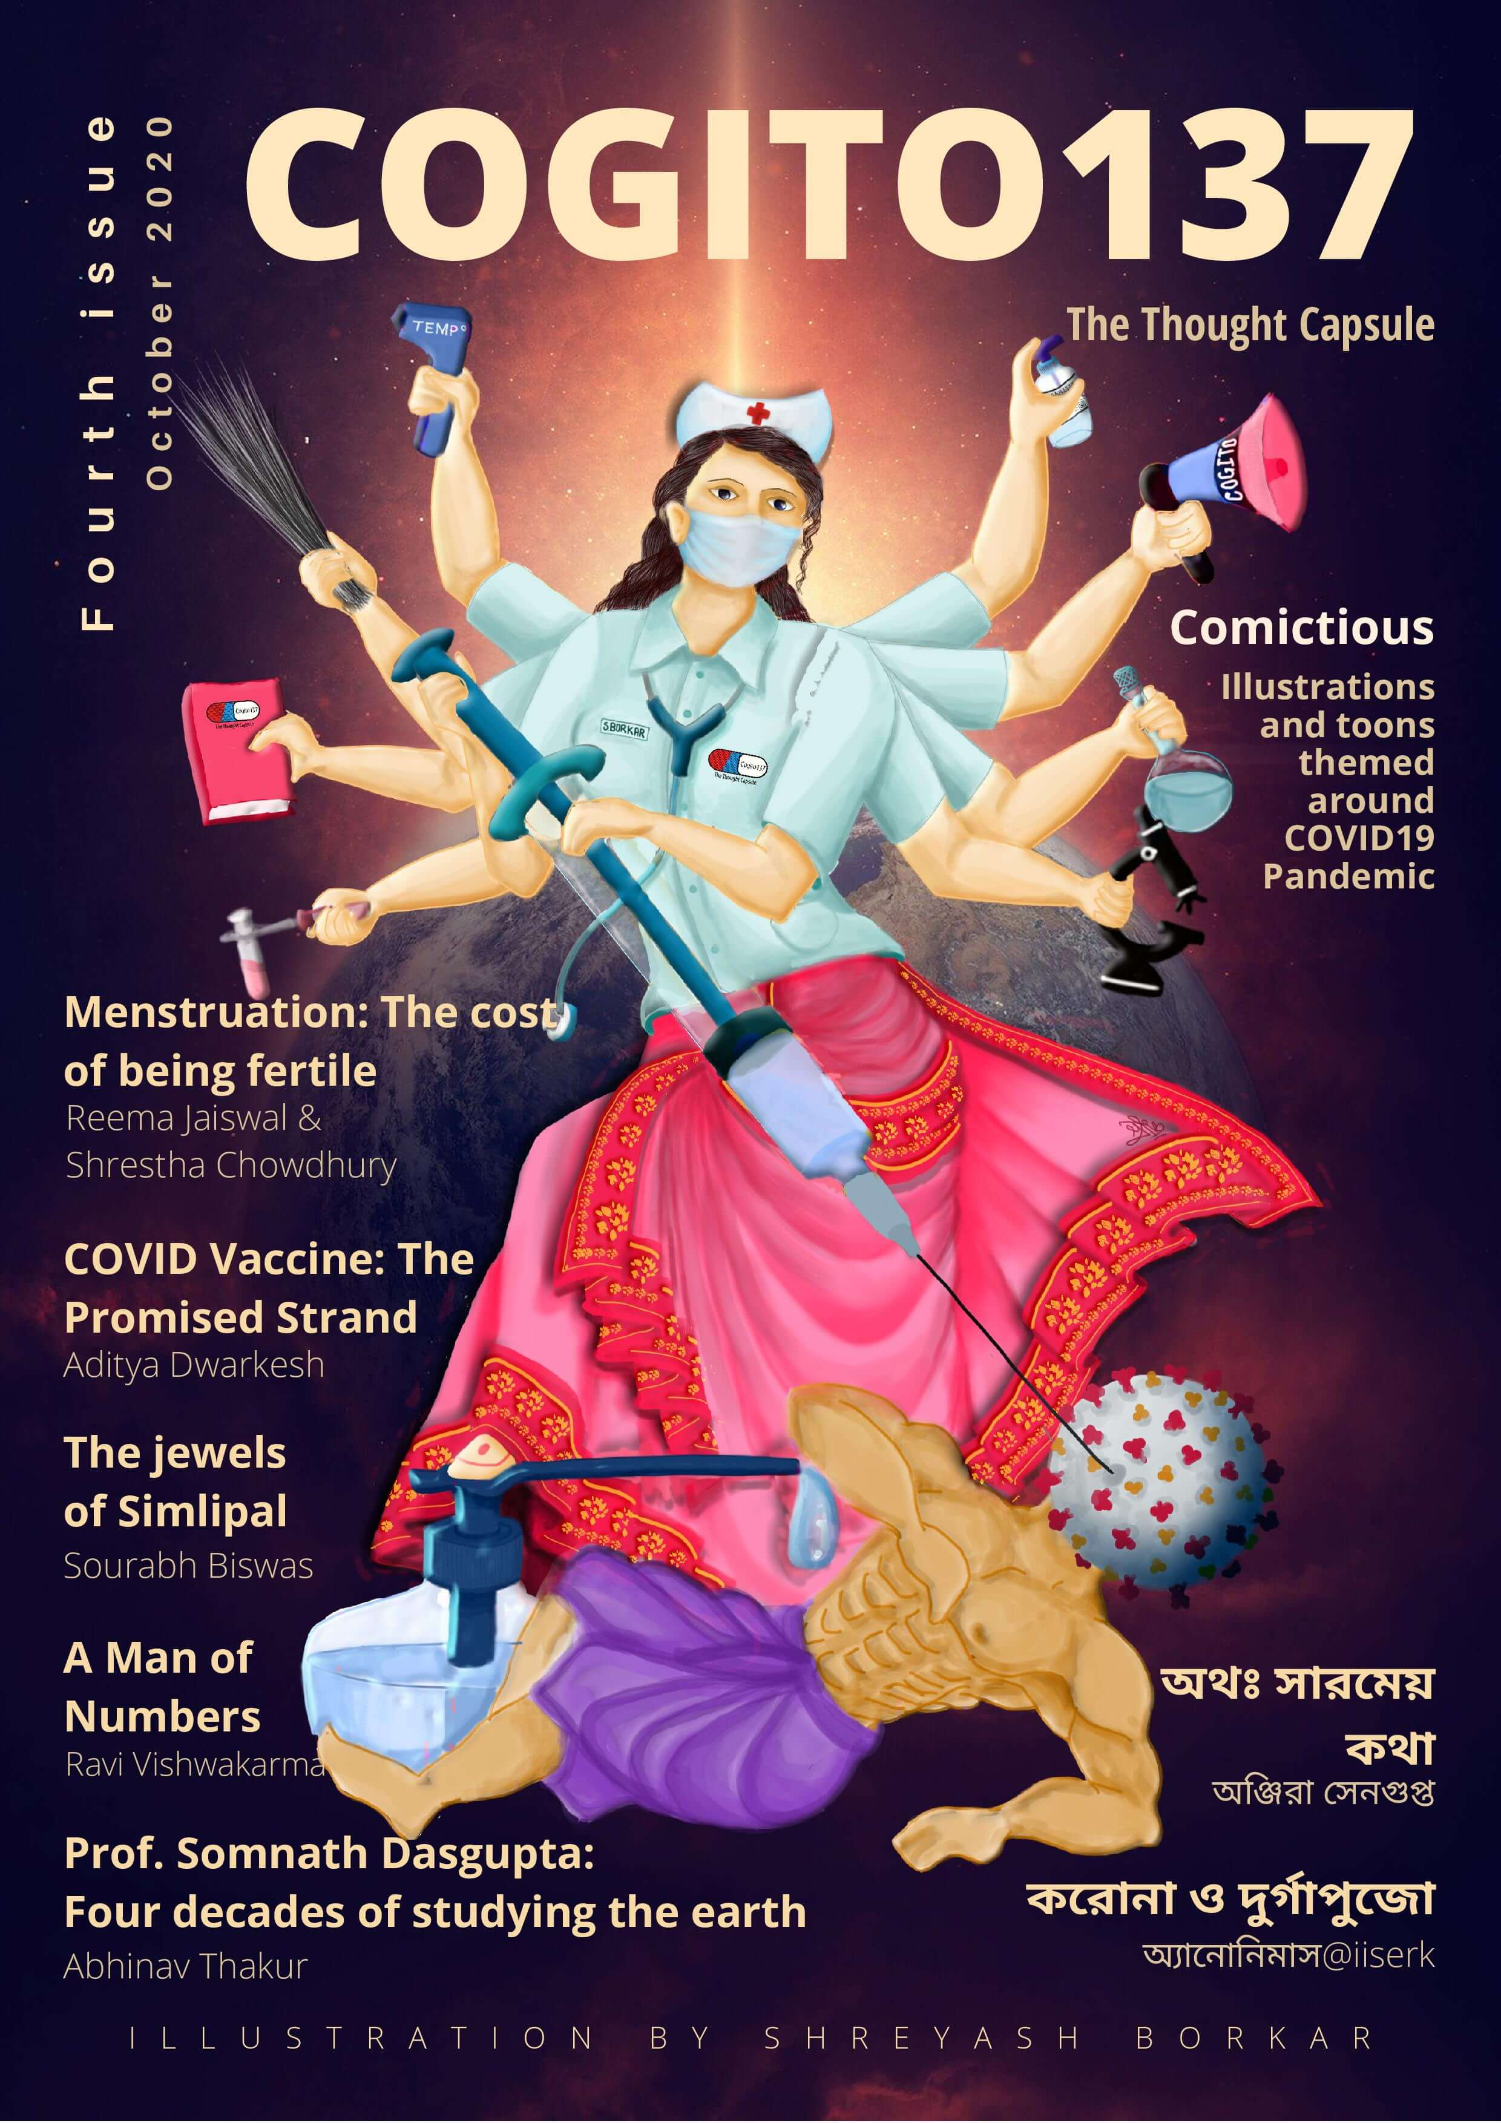

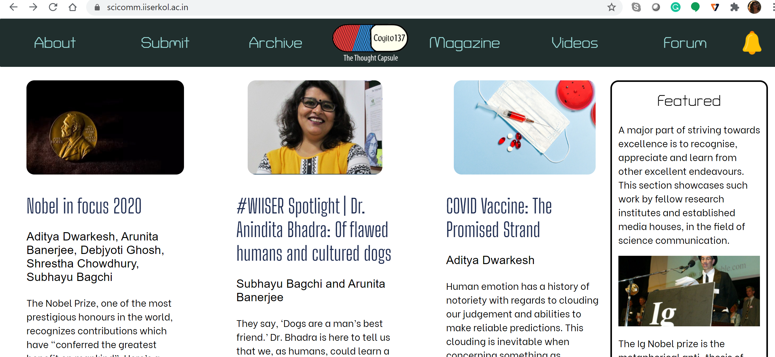
Cogi
Student-run Science Communication Platform

Slide 16
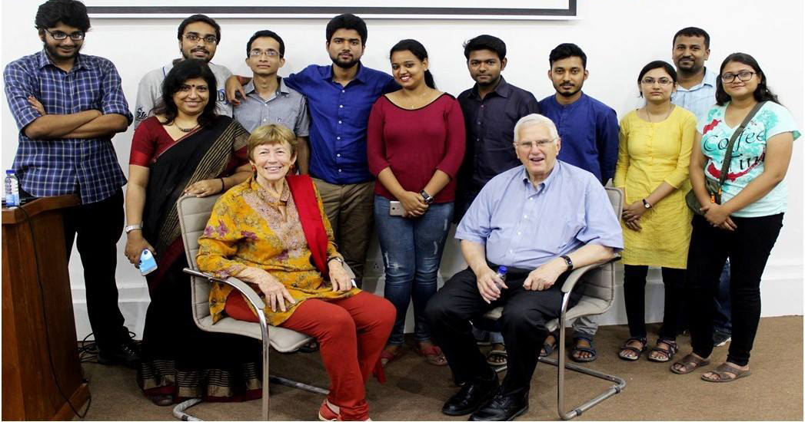
Student-run initiatve
Campus Radio
A student-run club that conducts various activities, including interviews of eminent scientists and visitors to the Institute and publishing a newsletter.

Slide 17
Points of Entry to IISER Kolkata
5-year BS-MS Dual Degree Program (August)
Post-BSc Integrated PhD Program (August)
PhD Program (August and January)
MS by Research (August)
Masters’ program (only DMS)
Postdoctoral Research Program

Slide 18
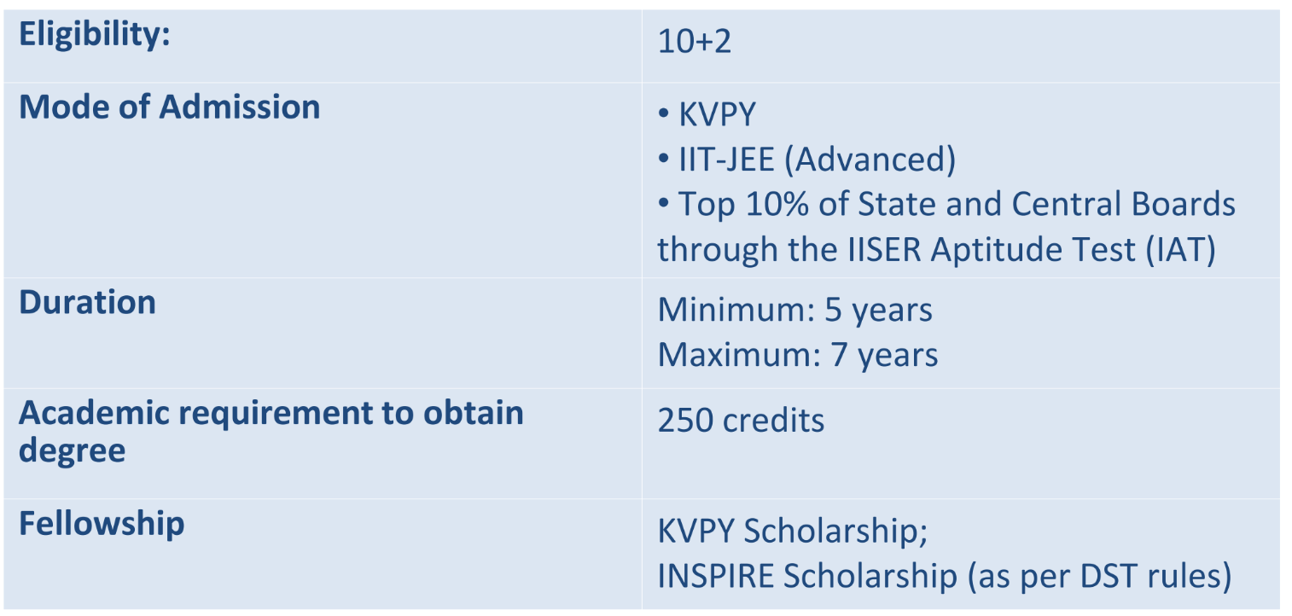
5-year BS-MS Dual Degree Program

Slide 19
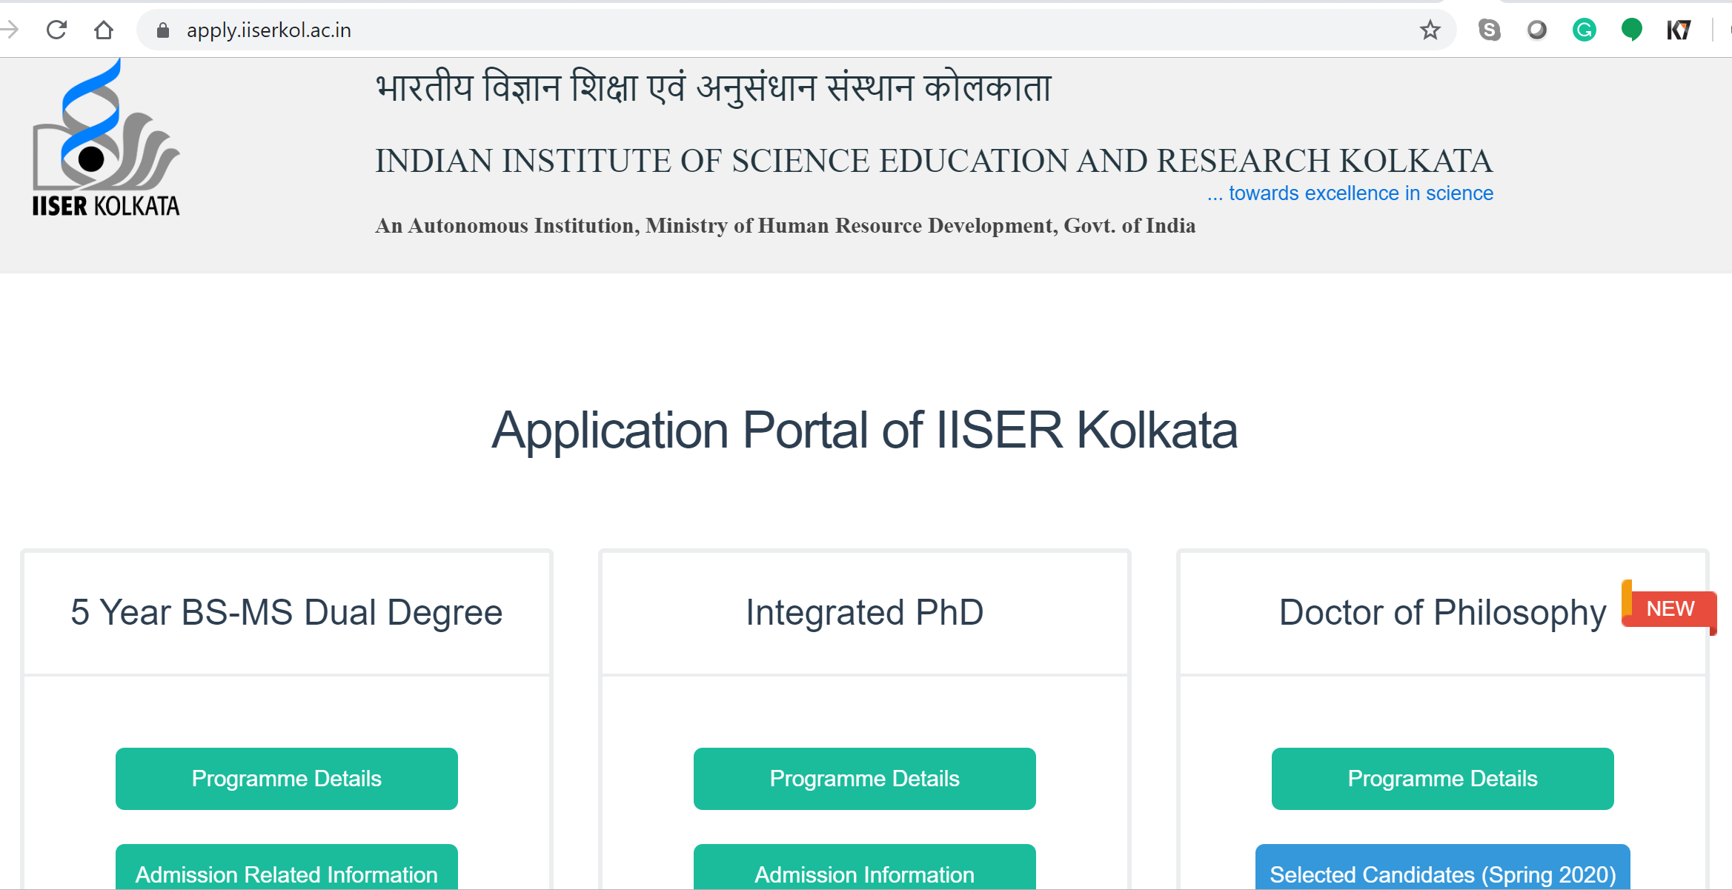
5-year BS-MS Dual Degree Program

Slide 20
Thank You

